Slide 1
Anatomy Detection using Inceptionv4 (Cogan 2019)
Sriram N C
26th April 2022
The code used in this review can be found here. Note- In the code, the MAPGI technique is referred to as "custom_preprocess" for the function and the module.

Slide 2
Inceptionv4
Inception-v4 is a convolutional neural network architecture that builds on previous iterations of the Inception family by simplifying the architecture and using more inception modules than Inception-v3.
Inception V4 was introduced in combination with Inception-ResNet by the researchers a Google in 2016. The main aim of the paper was to reduce the complexity of Inception V3 model which give the state-of-the-art accuracy on ILSVRC 2015 challenge.
Link to the official Inceptionv4 Paper

Slide 3
Inceptionv4
Inception-ResNet-v2 and Inception-v4 were trained using High Performance Computing (HPC) resources provided by Texas Advanced Computing Center (TACC).
Each of these models are state-of-the-art convolutional neural networks which have demonstrated strong performance in image classiﬁcation tasks.
Inception-v4 and Inception-ResNet-v2 were both described by Google engineers in 2016 and oﬀer similar performance. However, Inception-ResNet-v2 appears to oﬀer slightly better performance on ImageNet images due to residual connections.
Unlike normal connections, residual connections learn deviations from an identity function. That is, whereas a normal connection will try to optimize f(x), a residual connection will try to optimize f(x) + x. Empirically, these residual connections may lead to better results than normal connections.
Inception-v4 was created as an improvement to Inception-v3 with a goal of simplifying the overall Inception architecture while providing improved results. Inception-v4 is also a successor to GoogLeNet, also known as Inception-v1.

Slide 4
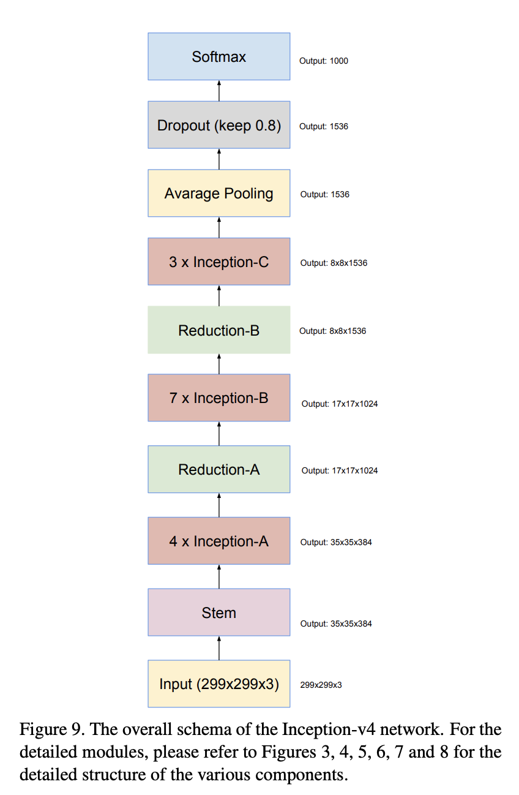
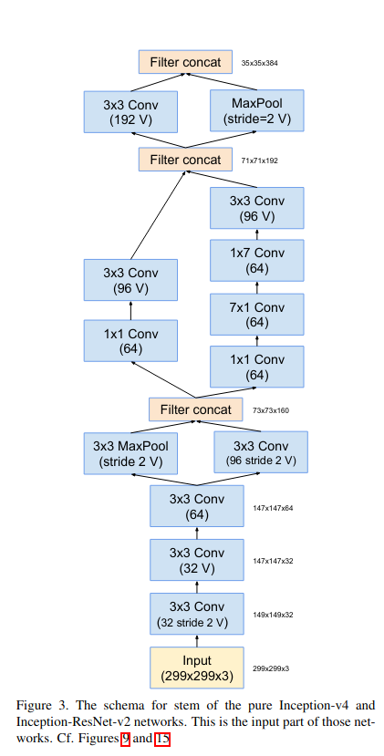
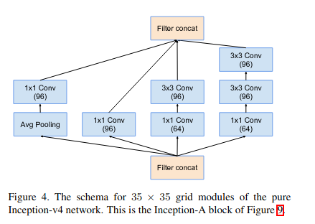

Slide 5
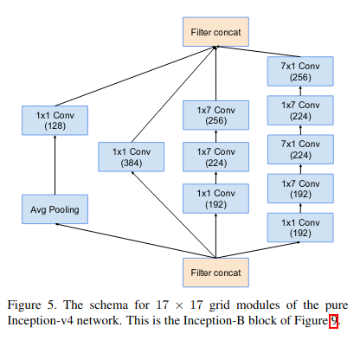
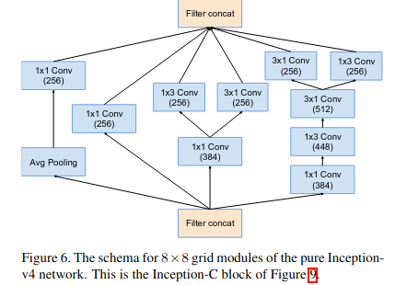

Slide 6
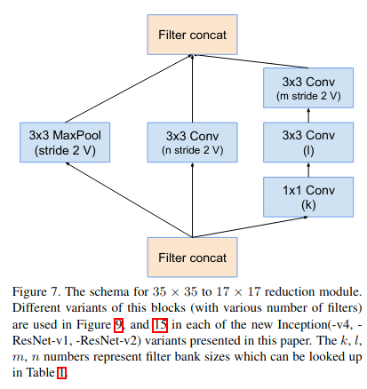
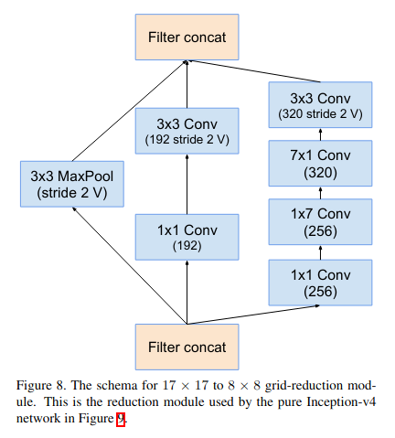
Inception v4 introduced specialized “Reduction Blocks” which are used to change the width and height of the grid. The earlier versions didn’t explicitly have reduction blocks, but the functionality was implemented.

Slide 7
Cogan 2019
MAPGI: Accurate identification of anatomical landmarks and diseased tissue in gastrointestinal tract using deep learning.
The full paper can be found here.
Automatic detection of anatomical landmarks and diseases in medical images is a challenging task which could greatly aid medical diagnosis and reduce the cost and time of investigational procedures.
Two particular challenges of digital image processing in medical applications are
1. the sparsity of annotated medical images and
2. the lack of uniformity across images and image classes

Slide 8
This paper presents methodologies for maximizing classiﬁcation accuracy on a small medical image dataset, the Kvasir dataset, by performing robust image pre-processing and applying state-of-the-art deep learning.
Images are classiﬁed as being or involving an anatomical landmark (pylorus, z-line, cecum), a diseased state (esophagitis, ulcerative colitis, polyps), or a medical procedure (dyed lifted polyps, dyed resection margins).
A framework for modular and automatic pre-processing of gastrointestinal tract images (MAPGI) is proposed, which applies edge removal, contrast enhancement, ﬁltering, colour mapping and scaling to each image in the dataset.

Slide 9
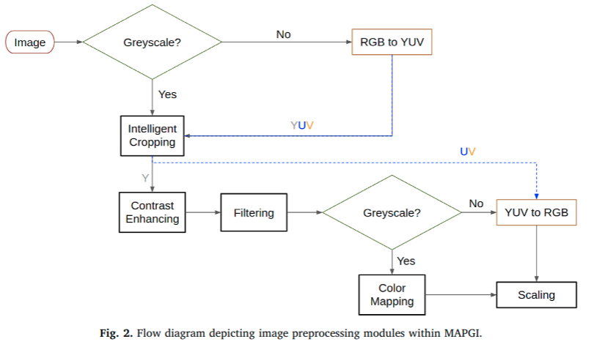
MAPGI (overview)

Slide 10
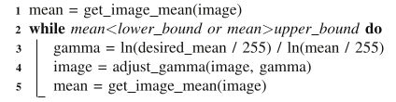
MAPGI (steps)
1. Edge Removal- Before this step, convert the image to YUV color space, where the Y component solely encodes image luminance (unlike RGB). Medical images commonly have undesirable and distracting edge artifacts/notations that are like black borders, white streaks caused by scanning instruments, and annotations. Any row or column where more than a predefined ratio of pixels are black (i.e, below the threshold value) are removed.
2. Contrast Enhancement- Consists of 2 key tools- Contrast-Limited Adaptive Histogram Equalization (CLAHE), and Mean-Approximated Gamma Value Adjustment (MAGVA). In the paper, MAGVA was used to create uniformity in image brightness and contrast across the dataset, setting the pixel mean value of each image to 90 ± 1. MAGVA enhances contrast across an entire image in a way that depends only on pixel value and not pixel location.

Slide 11
MAPGI (steps)
3. Filtering- Apply to only the Y component of a YUV image. To reduce out-of-band noise, apply a low-pass filter ([[0.1, 0.1, 0.1],[0.1, 1, 0.1],[0.1, 0.1, 0.1]])/1.8 across the entire image. Butterworth, Gaussian, and other 2D ﬁlter types may also be used.
4. Color Mapping- This is useful for enhancing potential greyscale images. A 12-bit greyscale to 24-bit RGB conversion may be convenient prior to feeding images into a pre-trained convolutional neural network. In the case of the Kvasir dataset, no color mapping was applied since all of the Kvasir images were already 24-bit color images. After this step, the image is converted back into the RGB space.
5. Scaling- MAPGI scaling utilizes bilinear interpolation. Bilinear interpolation is a relatively straightforward technique for two dimensional interpolation whereby linear interpolation is executed along each axis. Interpolation is ﬁrst performed along one axis, and then interpolation is performed along the remaining axis by use of the values produced via interpolation along the ﬁrst axis. For the Kvasir images, resizing was necessary because Inception-v4 expects 299 × 299 images.

Slide 12
MAPGI (steps)
6. Following MAPGI, dataset augmentation was performed to address the small number of samples available for training the network and reduce overﬁtting. This was done by randomly mirroring images along both the horizontal and vertical axes. In eﬀect, this helps the network learn what anatomical structures look like when viewed from different perspectives. The code for the augmentation is shown below:
datagen=ImageDataGenerator(
rescale=1/255,
rotation_range=40,
width_shift_range=0.1,
height_shift_range=0.1,
shear_range=0.1,
zoom_range=0.1,
horizontal_flip=True,
fill_mode='nearest',
samplewise_std_normalization=True,
preprocessing_function=mapgi
)

Slide 13
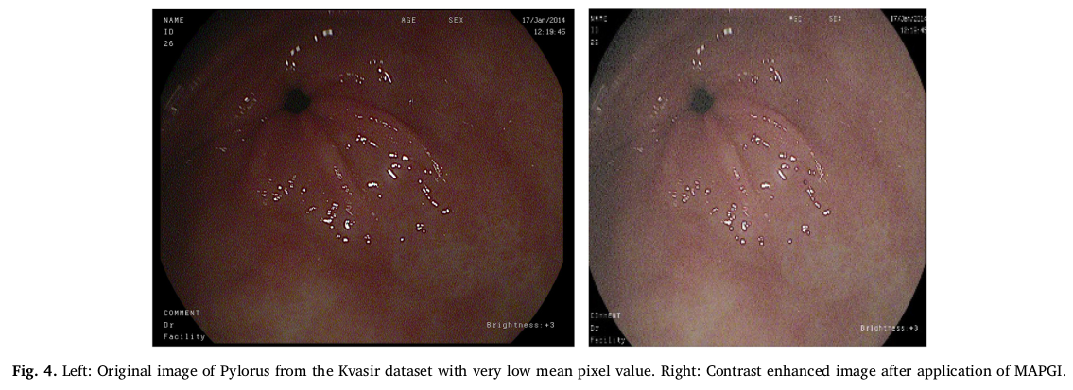
MAPGI Output From The Paper

Slide 14
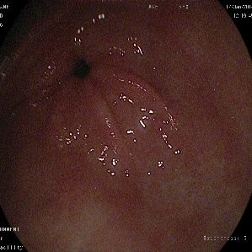
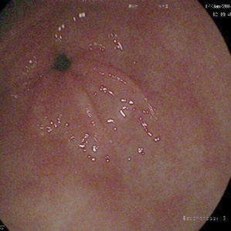
Obtained MAPGI Output
Left- input image, right- output image from our MAPGI implementation

Slide 15
Implementation
Hyper Kvasir dataset is downloaded from the website. Images from appropriate classes according to the research paper are placed in the train/ and val/ folders (80-20 split).
Command line arguments can be supplied to the training program, such as number of epochs, batch size, dataset directories, etc.
Data Augmentation is performed using ImageDataGenerator, such as rescaling, rotating, horizontal flipping, standard normalisation, etc. In addition, MAPGI algorithm is applied on training image.
Evaluate program runs on images in a directory using the model trained for a given number of epochs and creates a confusion matrix to analyse the results.
The code used in this review can be found here.

Slide 16
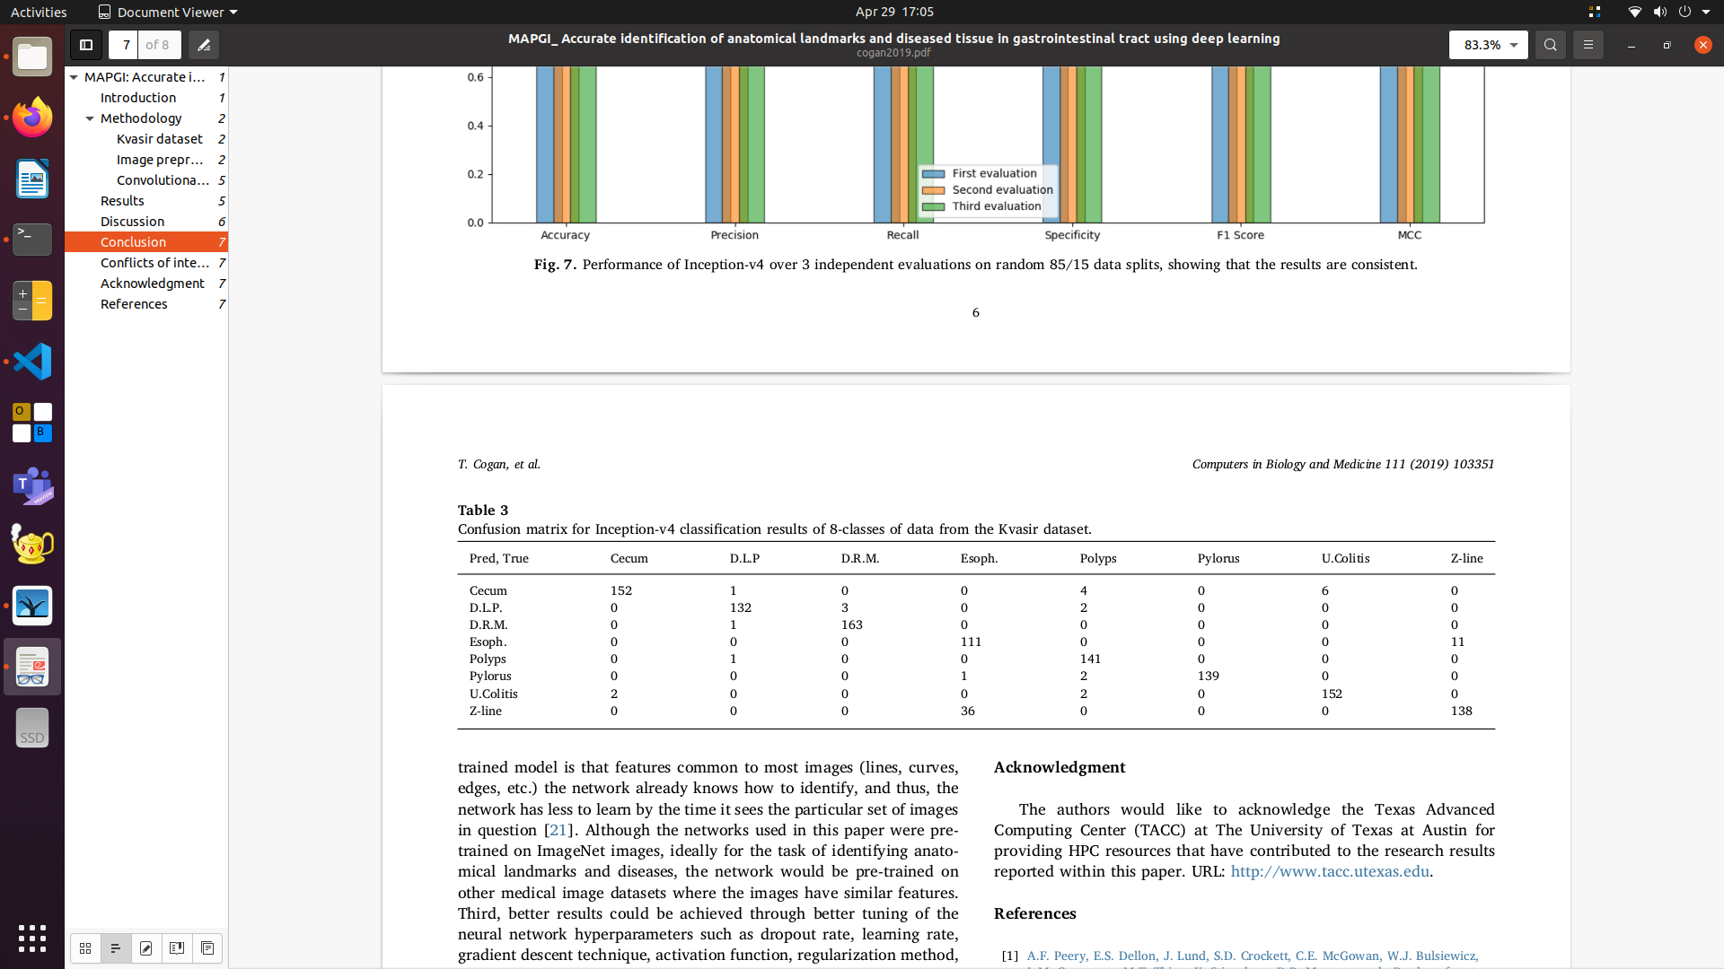
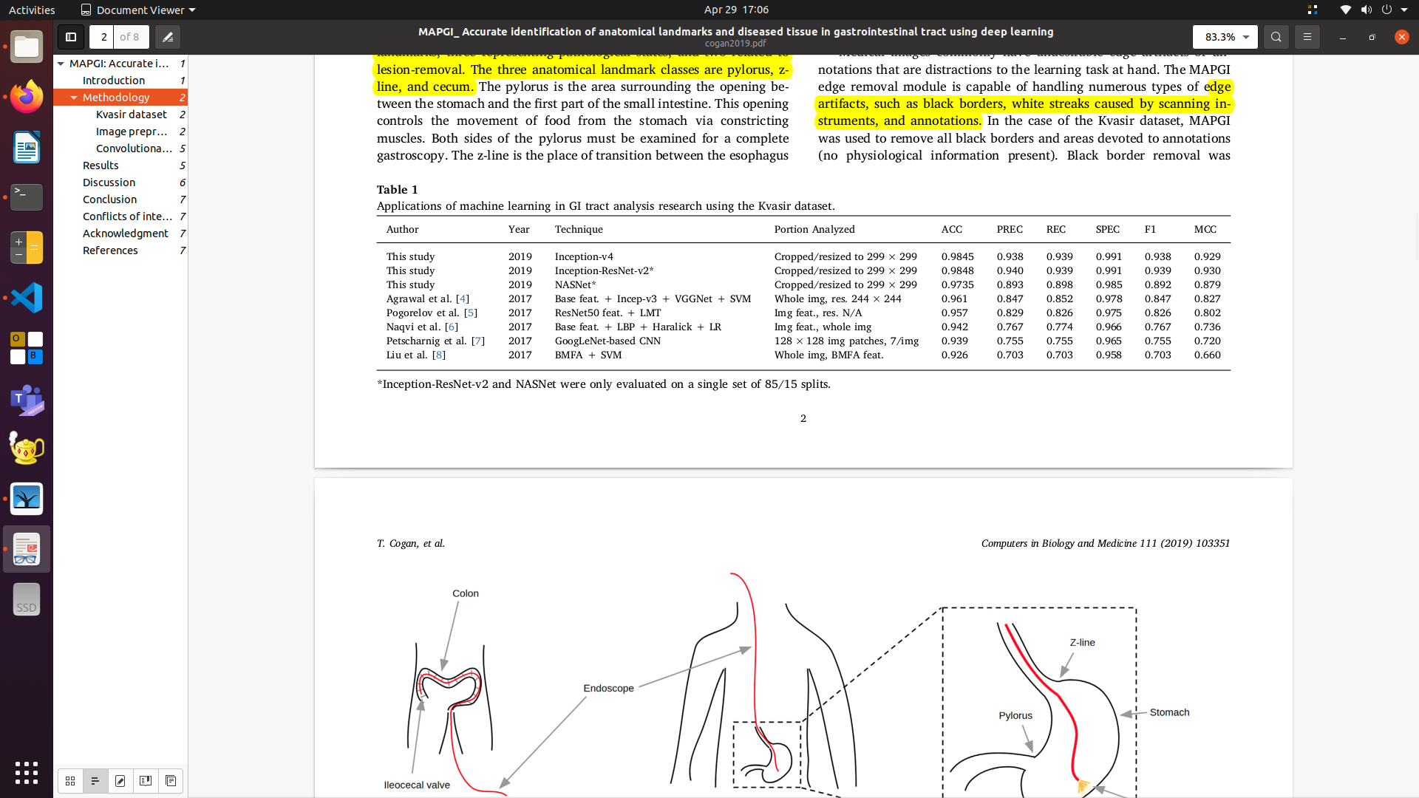
Results Obtained by the Paper's Authors

Slide 17
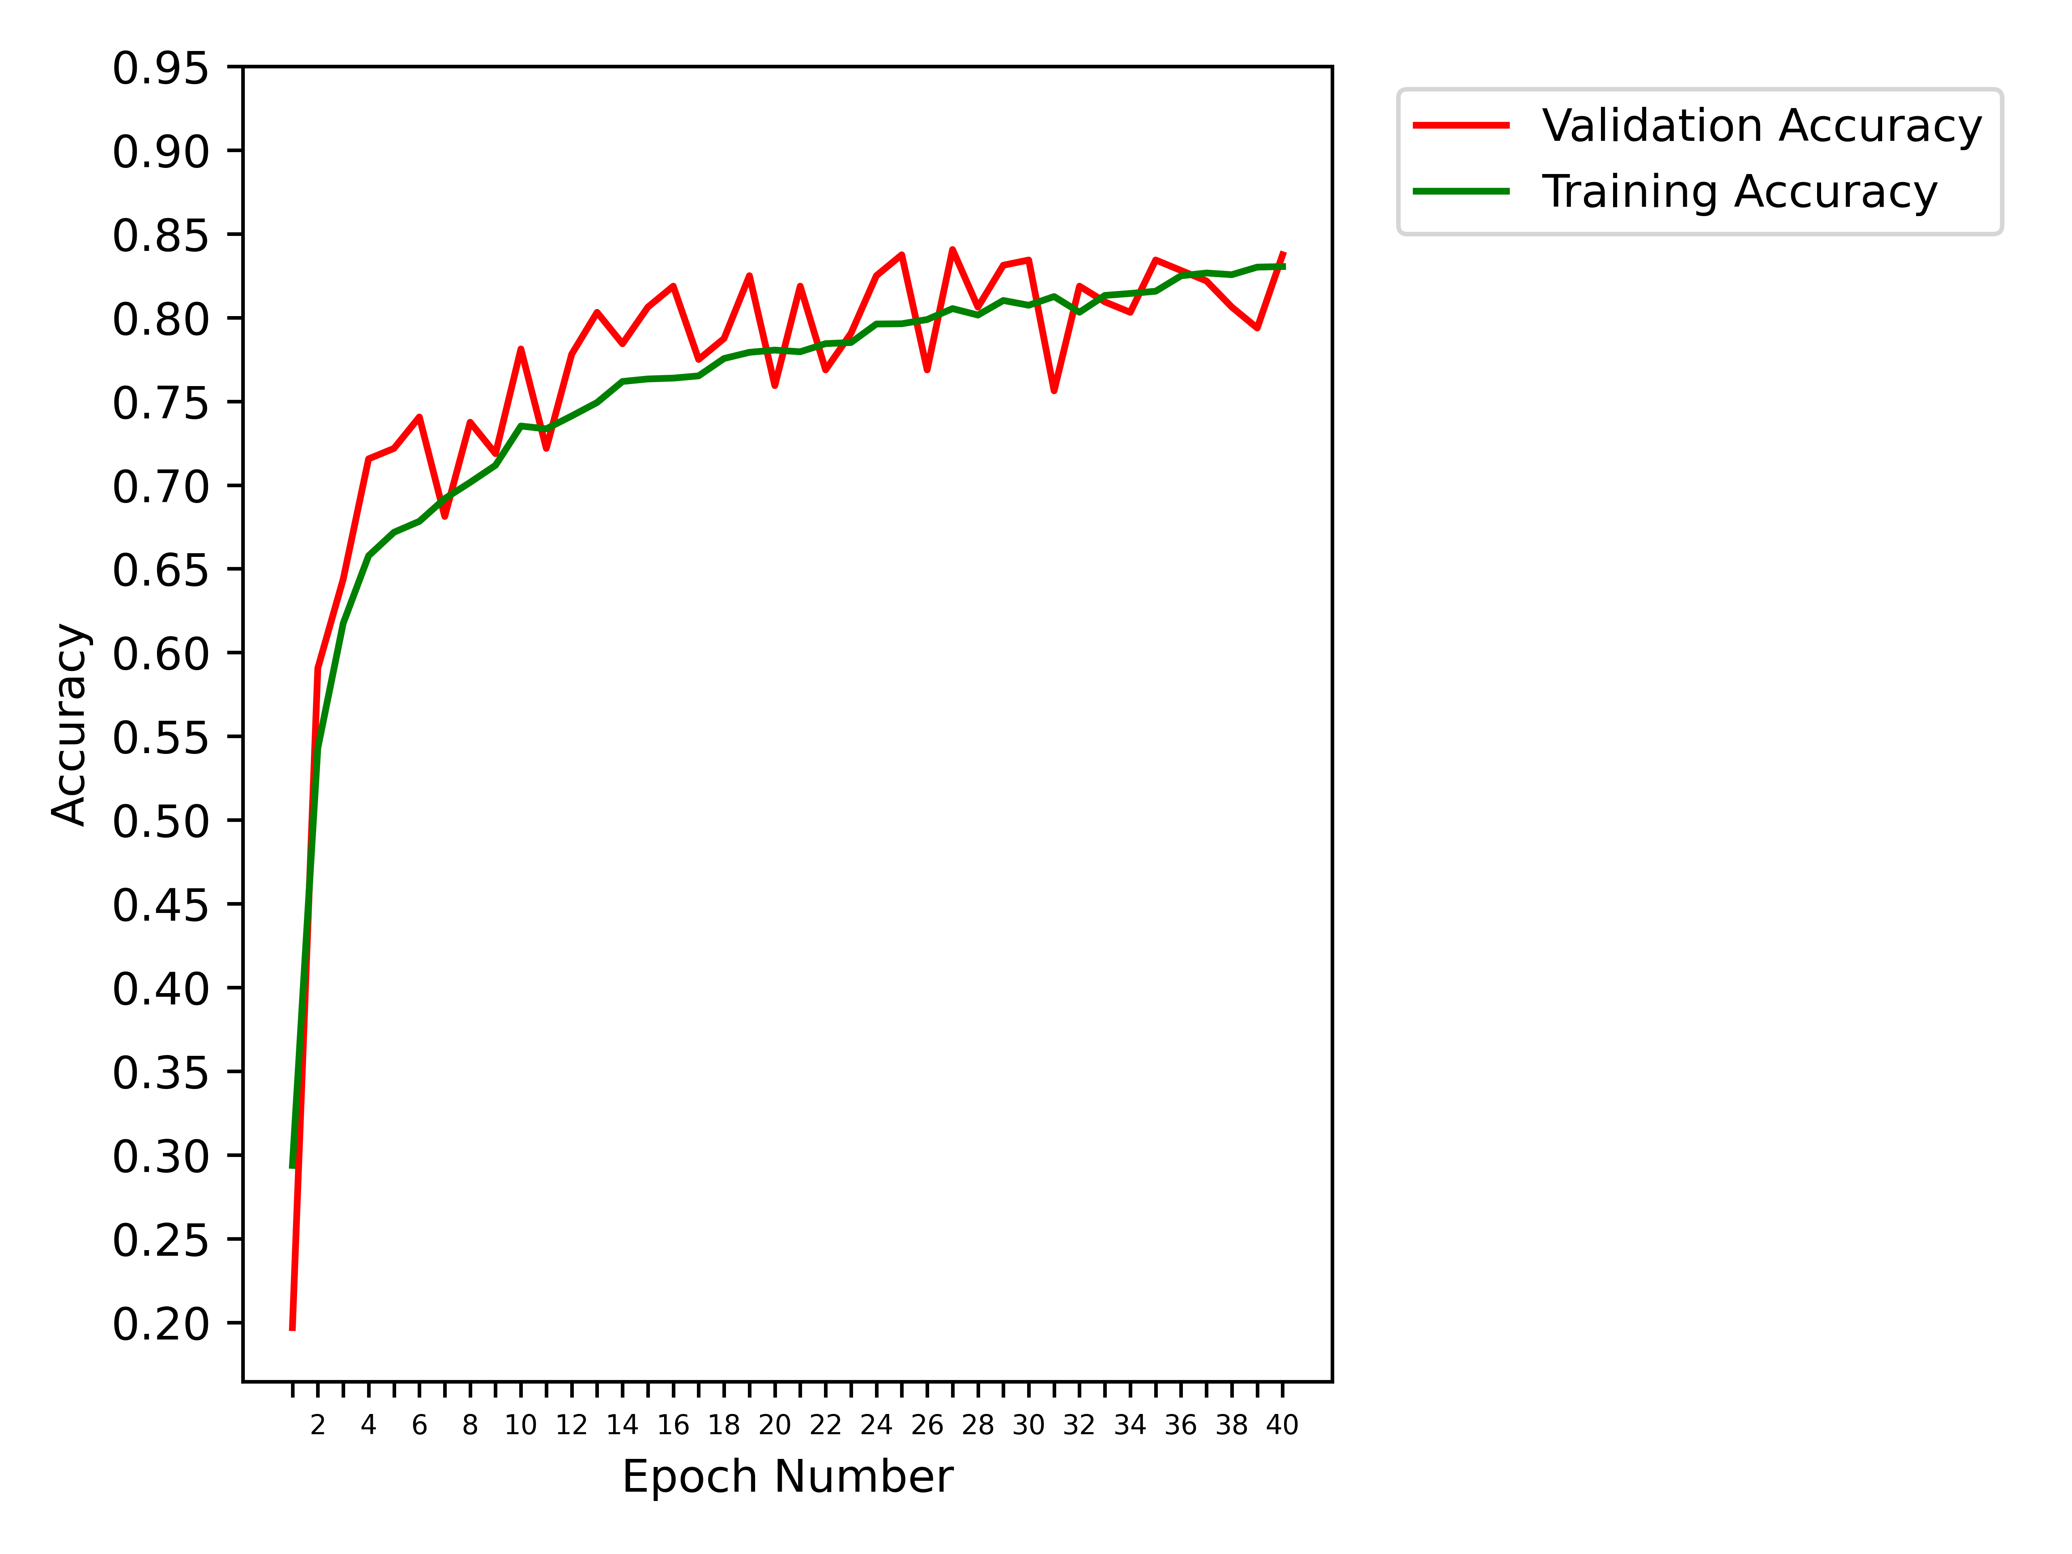
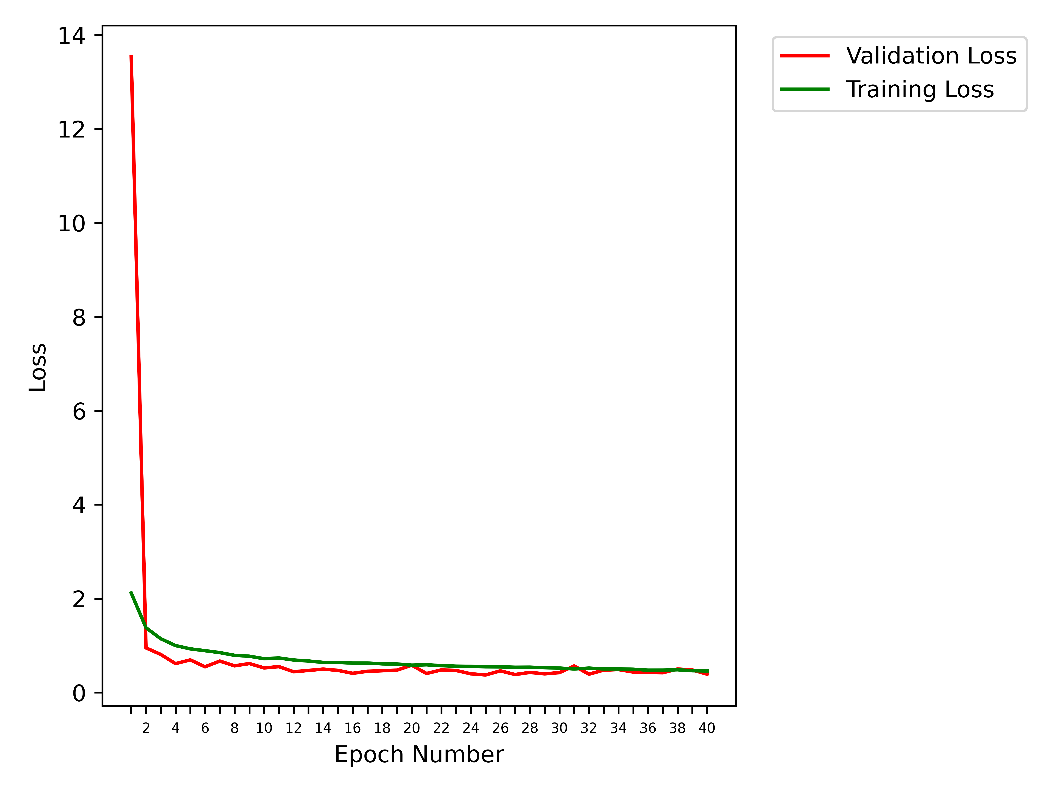
Obtained Results (8 classes)
40 epochs, SGD, no MAPGI

Slide 18
Obtained Results (8 classes)
40 epochs, SGD, no MAPGI
Class | cecum | dyed-lifted-polyps | dyed-resection-margins | esophagitis | polyps | pylorus | ulcerative-colitis | z-line
cecum | 194 | 1 | 1 | 0 | 0 | 0 | 6 | 0
dyed-lifted-polyps | 1 | 183 | 16 | 0 | 0 | 0 | 1 | 0
dyed-resection-margins | 0 | 67 | 130 | 1 | 0 | 0 | 0 | 0
esophagitis | 0 | 0 | 0 | 88 | 0 | 0 | 0 | 45
polyps | 1 | 0 | 0 | 0 | 182 | 1 | 22 | 0
pylorus | 0 | 0 | 0 | 2 | 6 | 187 | 5 | 0
ulcerative-colitis | 7 | 0 | 0 | 0 | 3 | 0 | 161 | 0
z-line | 0 | 0 | 0 | 53 | 0 | 2 | 0 | 132

Slide 19
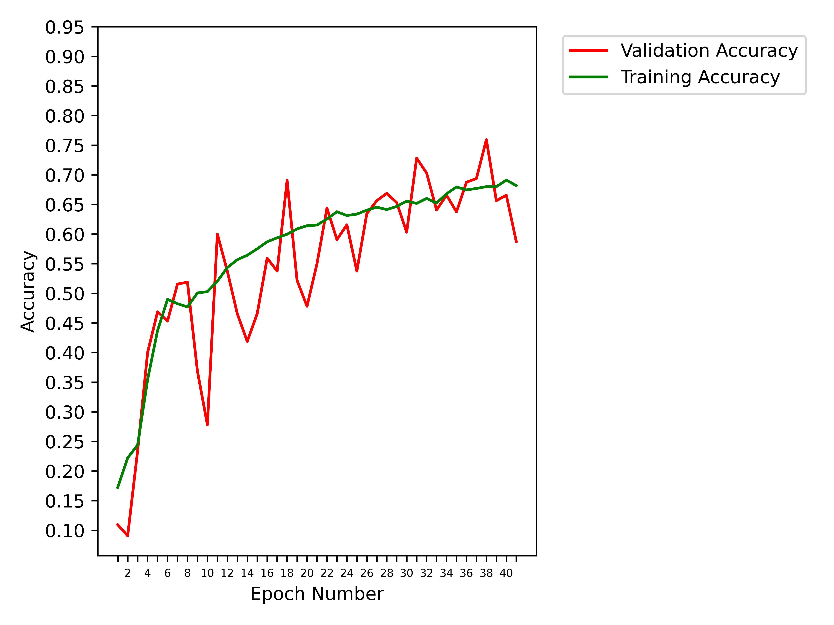
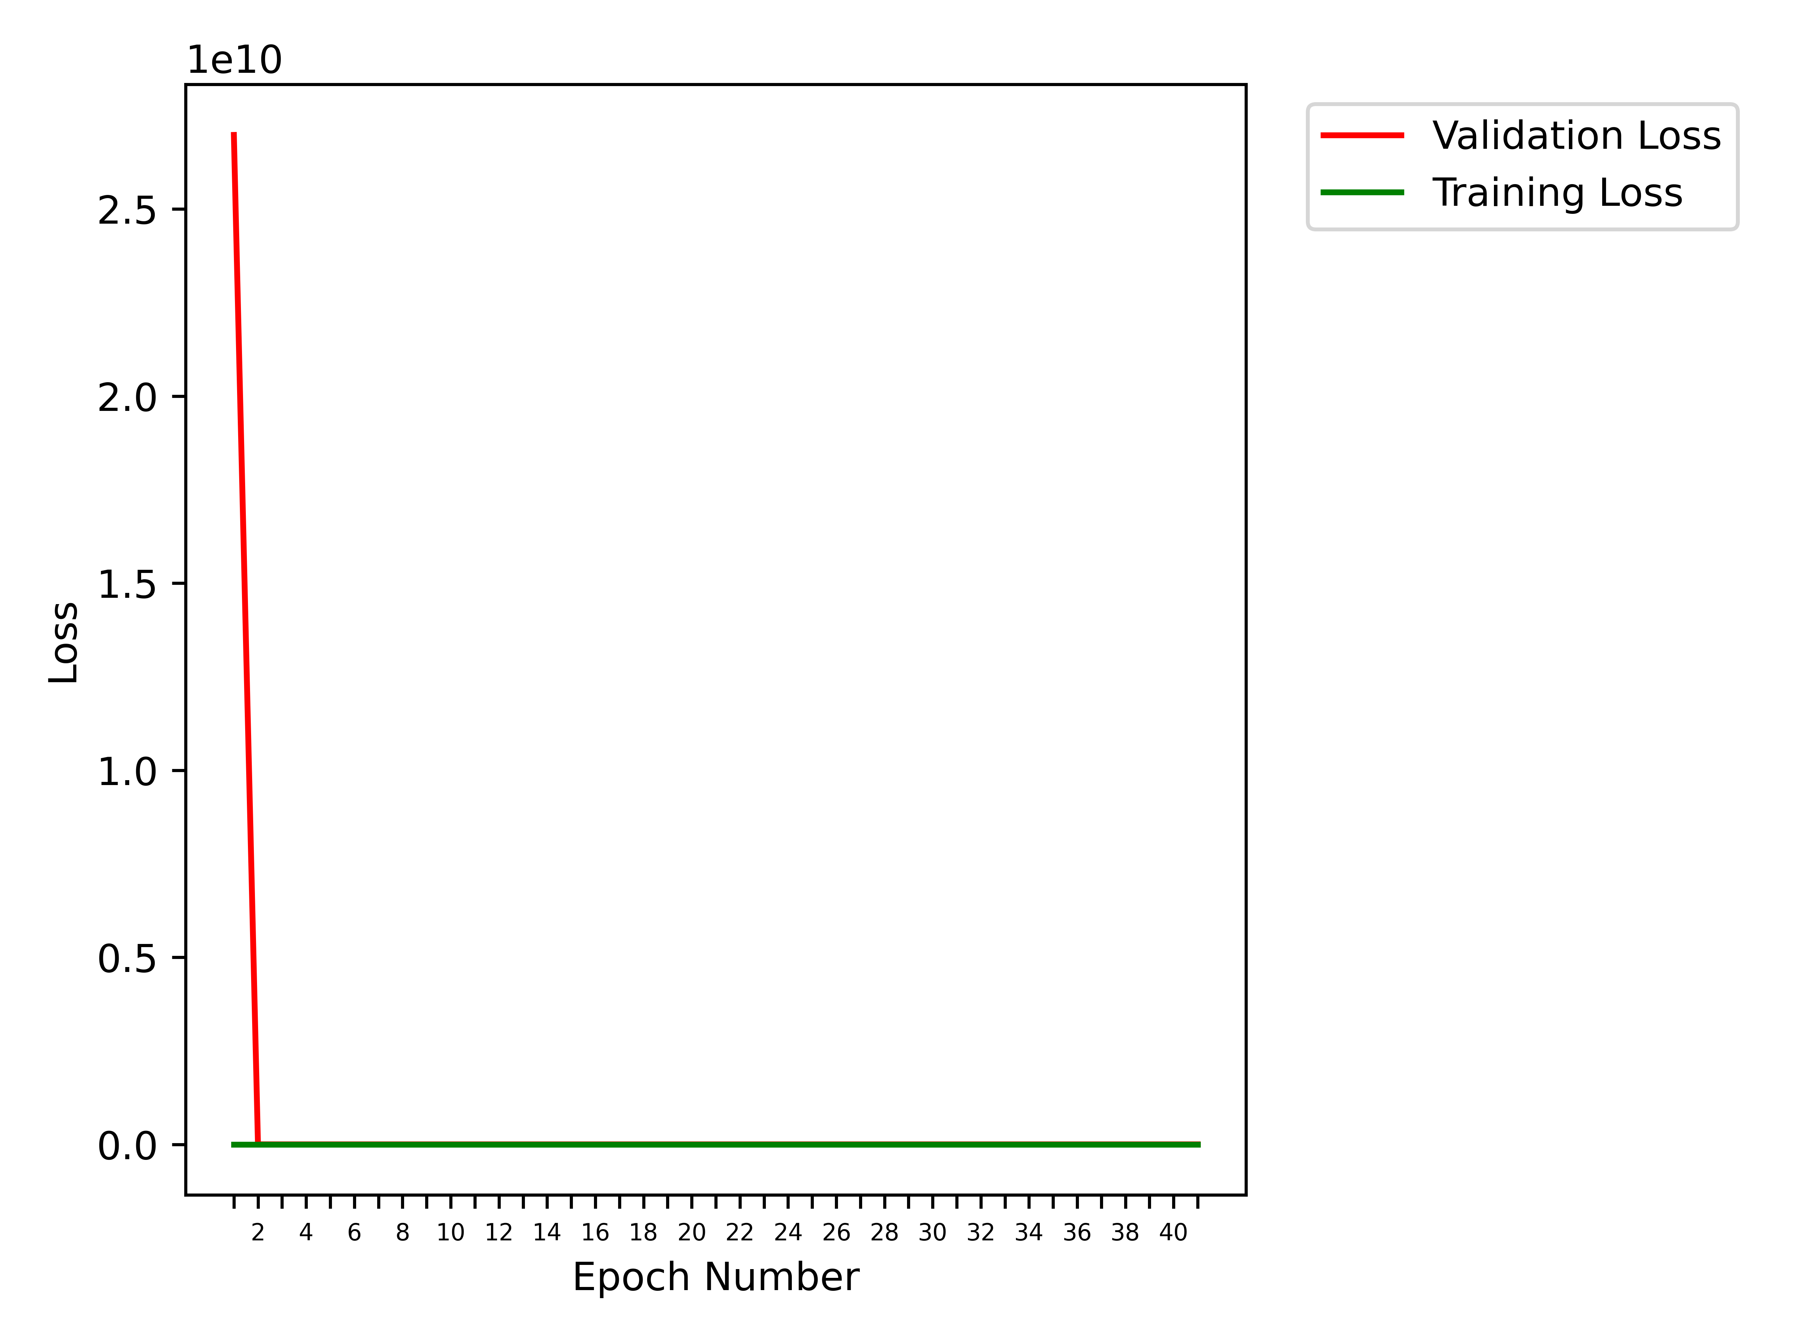
Obtained Results (8 classes)
41 epochs
RMSProp optimizer
no MAPGI

Slide 20
Obtained Results (8 classes)
41 epochs, RMSProp, no MAPGI
Class | cecum | dyed-lifted-polyps | dyed-resection-margins | esophagitis | polyps | pylorus | ulcerative-colitis | z-line
cecum | 121 | 2 | 0 | 0 | 3 | 0 | 76 | 0
dyed-lifted-polyps | 0 | 172 | 28 | 0 | 0 | 0 | 1 | 0
dyed-resection-margins | 0 | 118 | 80 | 0 | 0 | 0 | 0 | 0
esophagitis | 0 | 0 | 0 | 120 | 0 | 0 | 1 | 12
polyps | 1 | 2 | 0 | 2 | 102 | 11 | 88 | 0
pylorus | 0 | 0 | 0 | 12 | 0 | 167 | 4 | 17
ulcerative-colitis | 4 | 2 | 0 | 5 | 25 | 20 | 115 | 0
z-line | 0 | 0 | 0 | 136 | 0 | 1 | 0 | 50

Slide 21
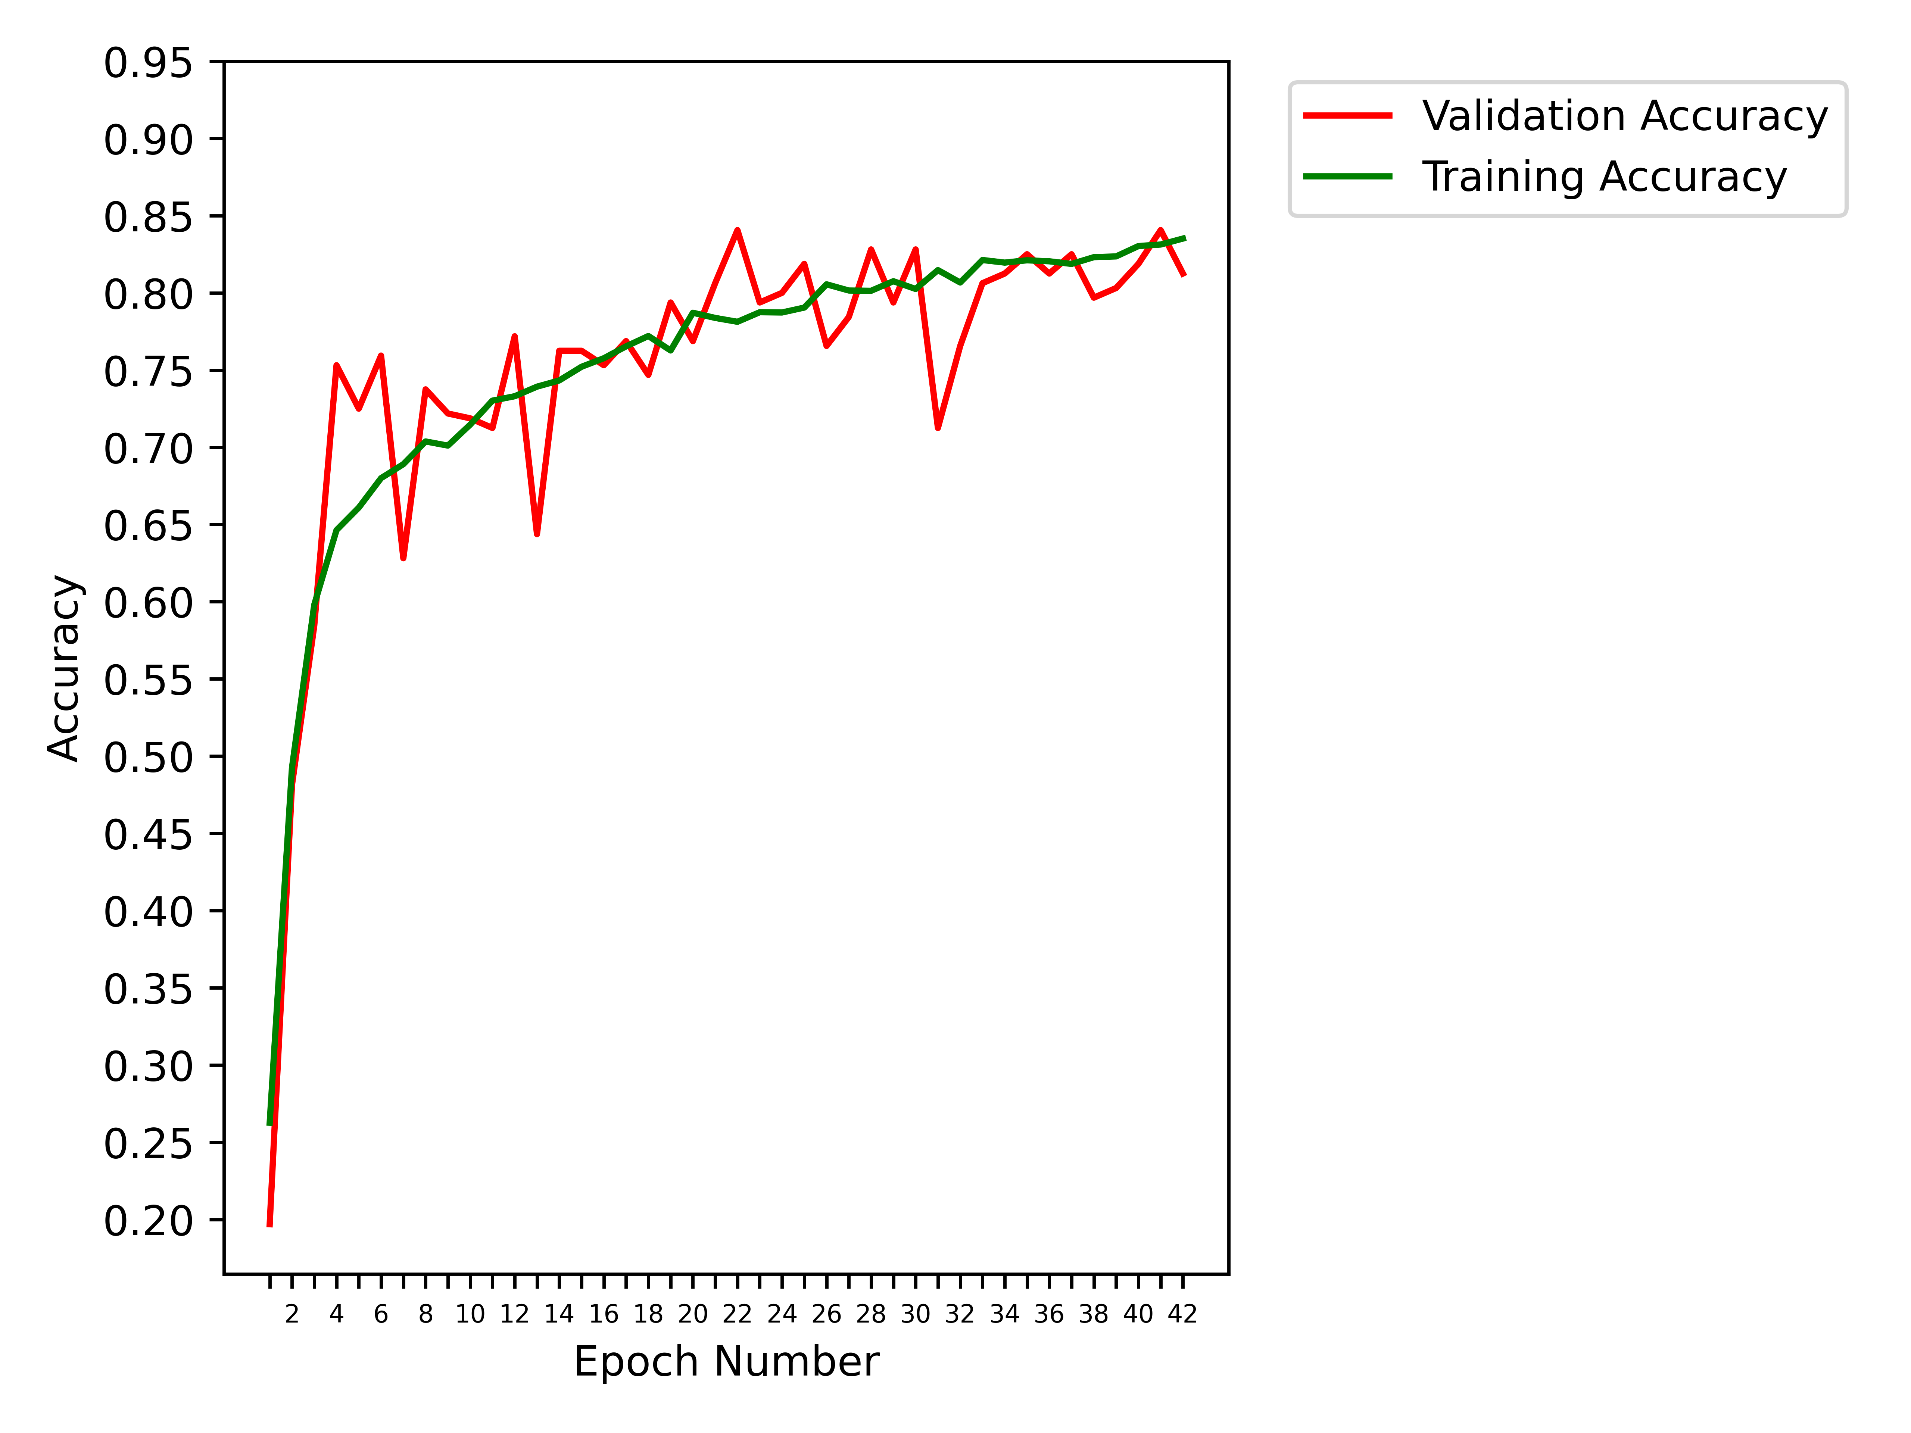
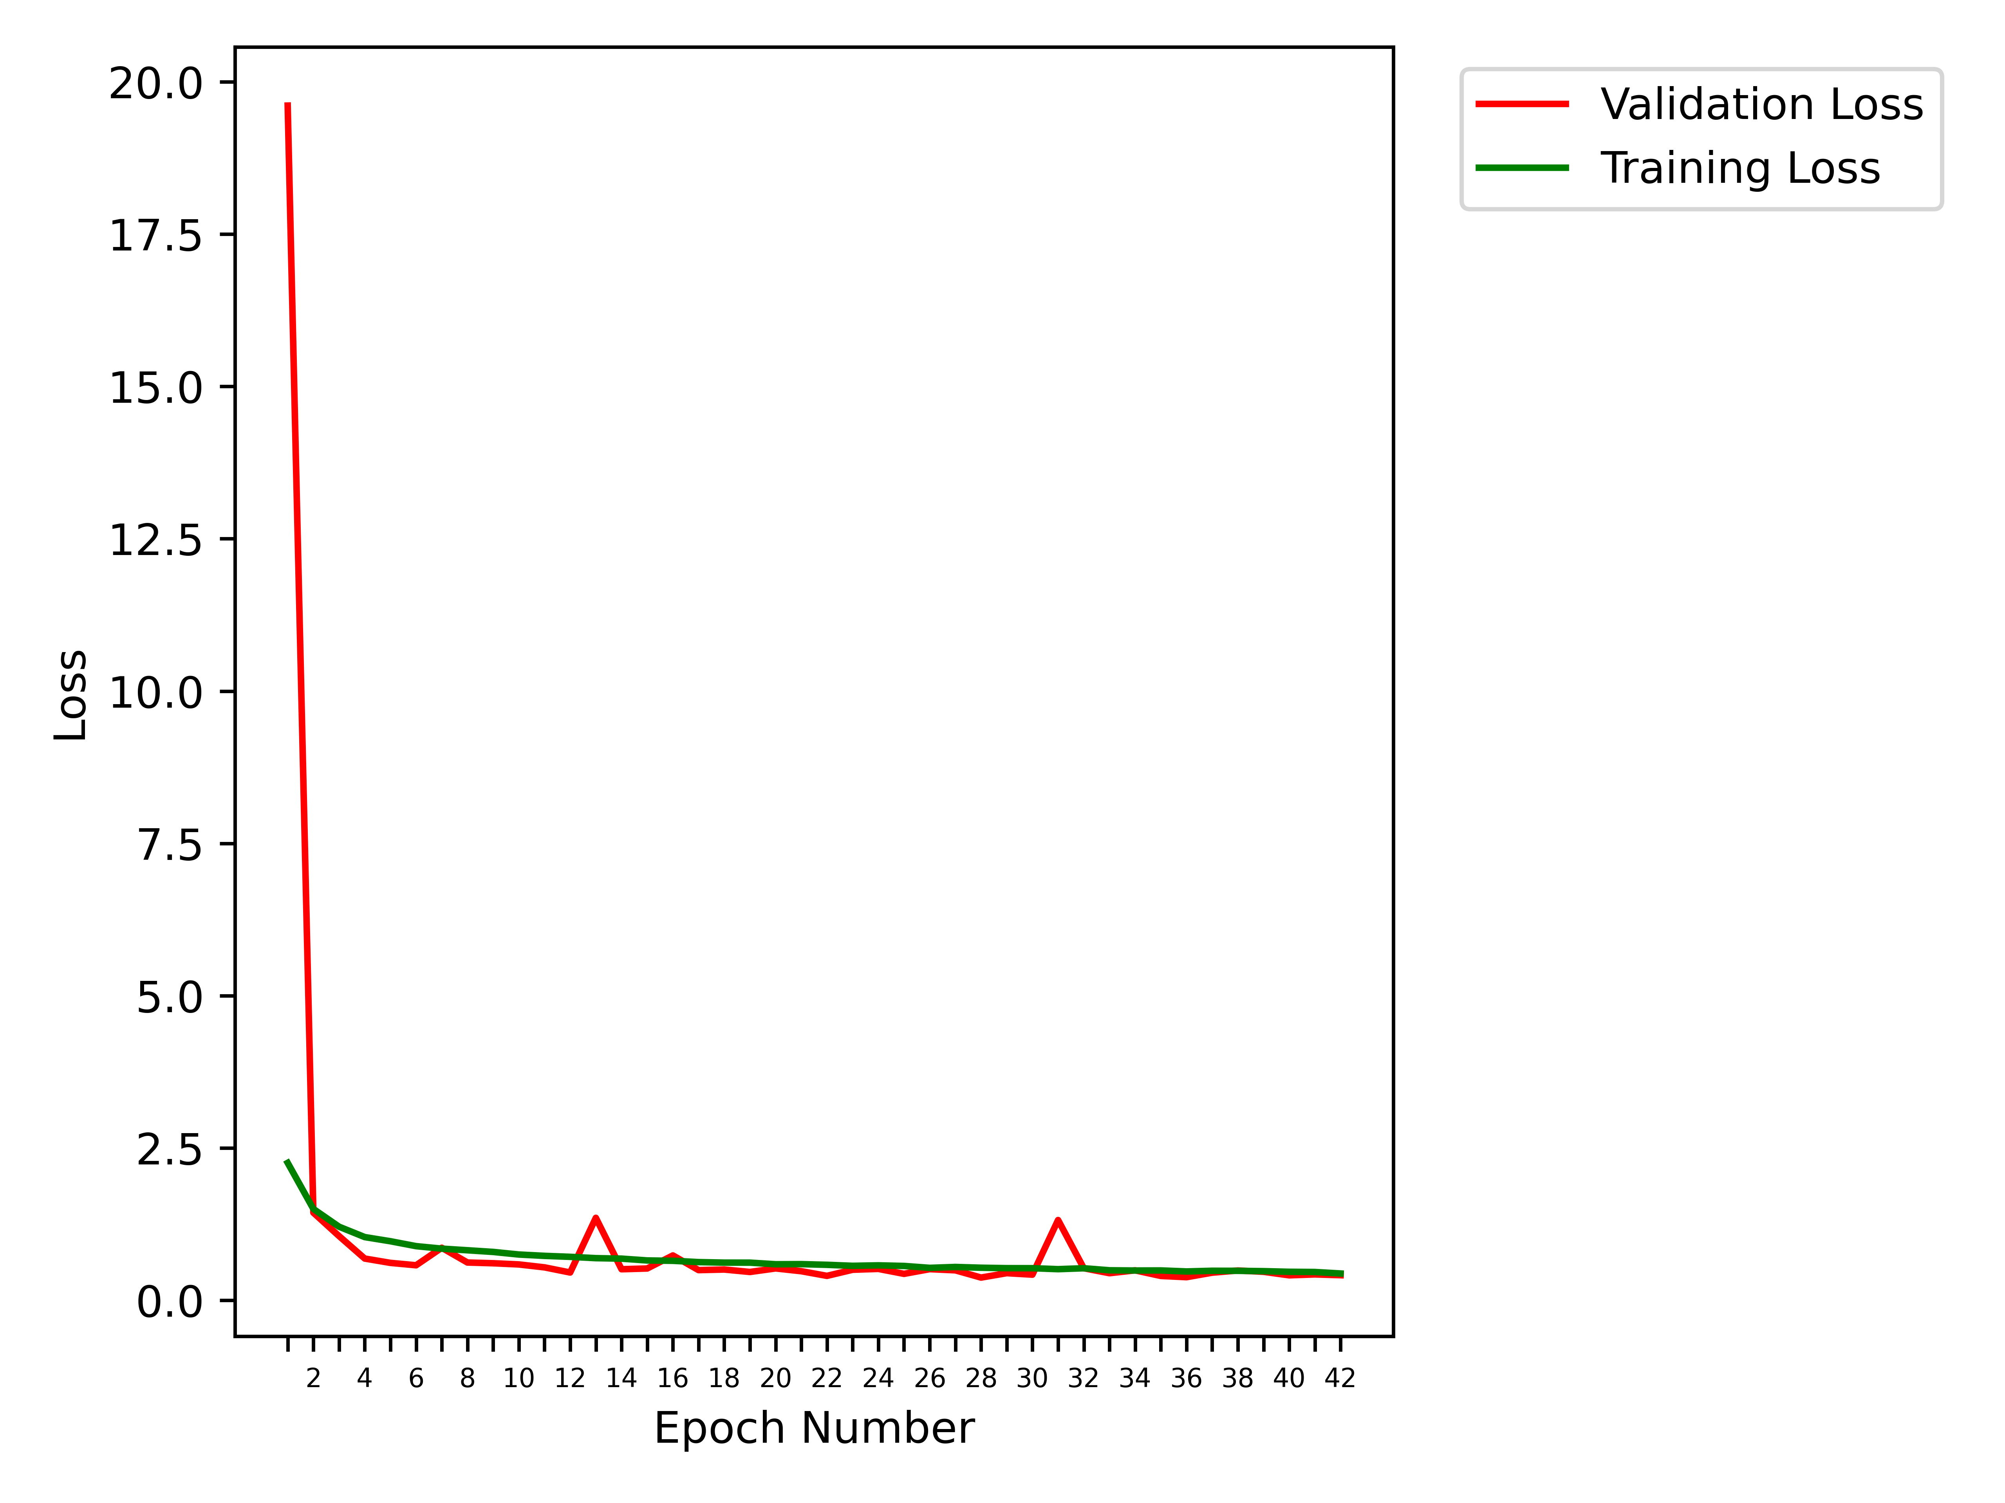
Obtained Results (8 classes)
42 epochs, SGD, MAPGI

Slide 22
Obtained Results (8 classes)
42 epochs, SGD, MAPGI
Class | cecum | dyed-lifted-polyps | dyed-resection-margins | esophagitis | polyps | pylorus | ulcerative-colitis | z-line
cecum | 177 | 2 | 0 | 0 | 1 | 0 | 22 | 0
dyed-lifted-polyps | 1 | 195 | 4 | 0 | 1 | 0 | 0 | 0
dyed-resection-margins | 0 | 137 | 61 | 0 | 0 | 0 | 0 | 0
esophagitis | 0 | 0 | 0 | 88 | 0 | 0 | 0 | 45
polyps | 1 | 0 | 0 | 0 | 195 | 1 | 8 | 1
pylorus | 0 | 0 | 0 | 2 | 4 | 190 | 0 | 4
ulcerative-colitis | 1 | 0 | 0 | 0 | 21 | 1 | 148 | 0
z-line | 0 | 0 | 0 | 32 | 1 | 1 | 0 | 153

Slide 23
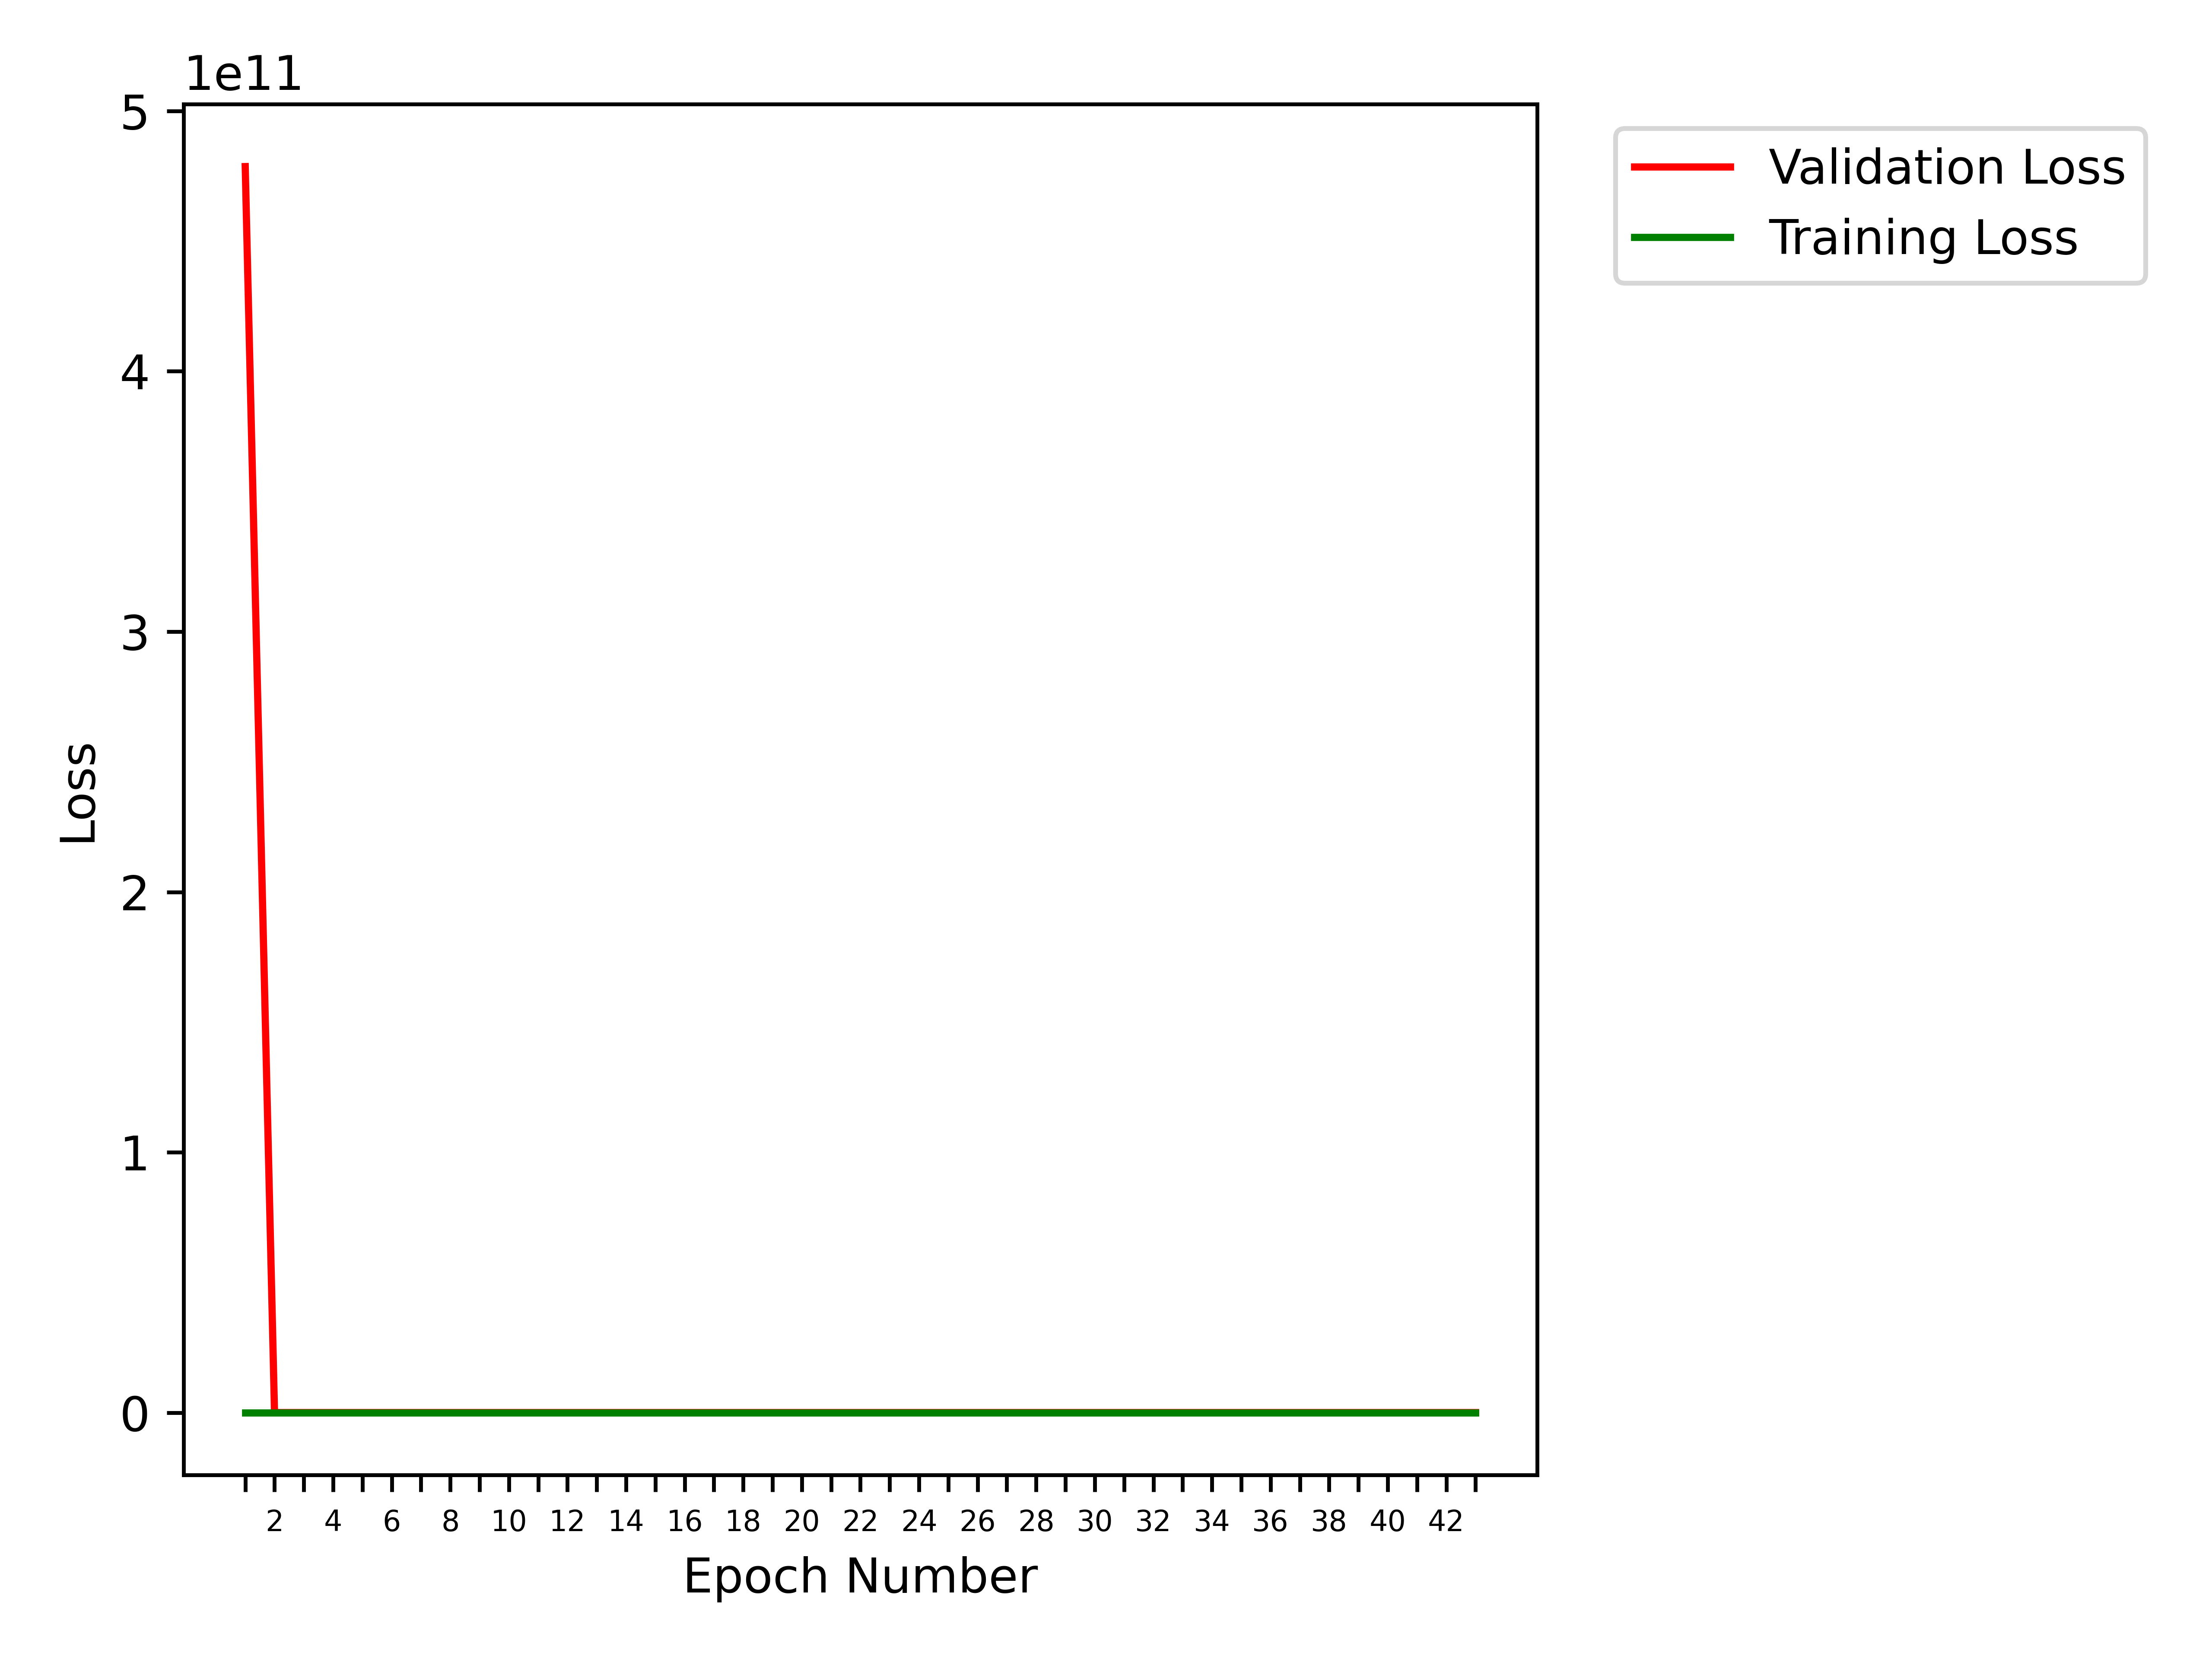
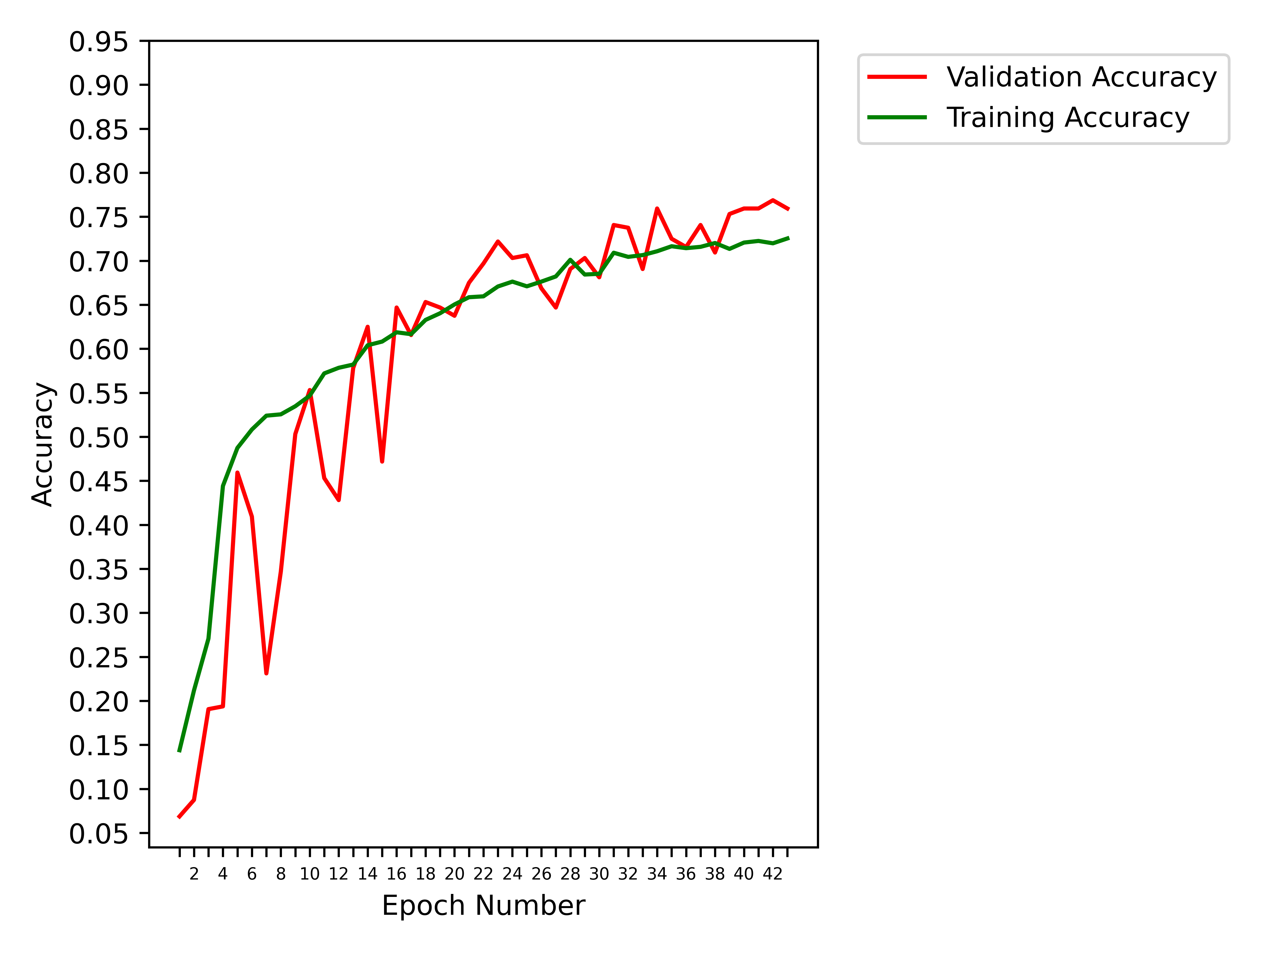
Obtained Results (8 classes)
43 epochs, RMSProp, MAPGI

Slide 24
Obtained Results (8 classes)
43 epochs, RMSProp, MAPGI
Class | cecum | dyed-lifted-polyps | dyed-resection-margins | esophagitis | polyps | pylorus | ulcerative-colitis | z-line
cecum | 188 | 2 | 0 | 0 | 4 | 0 | 8 | 0
dyed-lifted-polyps | 0 | 117 | 83 | 0 | 1 | 0 | 0 | 0
dyed-resection-margins | 0 | 49 | 149 | 0 | 0 | 0 | 0 | 0
esophagitis | 0 | 0 | 0 | 81 | 0 | 0 | 1 | 51
polyps | 1 | 2 | 0 | 0 | 196 | 3 | 3 | 1
pylorus | 0 | 0 | 0 | 2 | 7 | 179 | 3 | 9
ulcerative-colitis | 13 | 2 | 0 | 2 | 68 | 1 | 85 | 0
z-line | 0 | 0 | 0 | 50 | 0 | 2 | 0 | 135

Slide 25
Obtained Results for six classes
Due to the significant overlap between Dyed Lifted Polyps and Dyed Resection Margins in all the eight-class predictions, we have evaluated the performance of our model on only six classes, after excluding the two aforementioned classes.

Slide 26
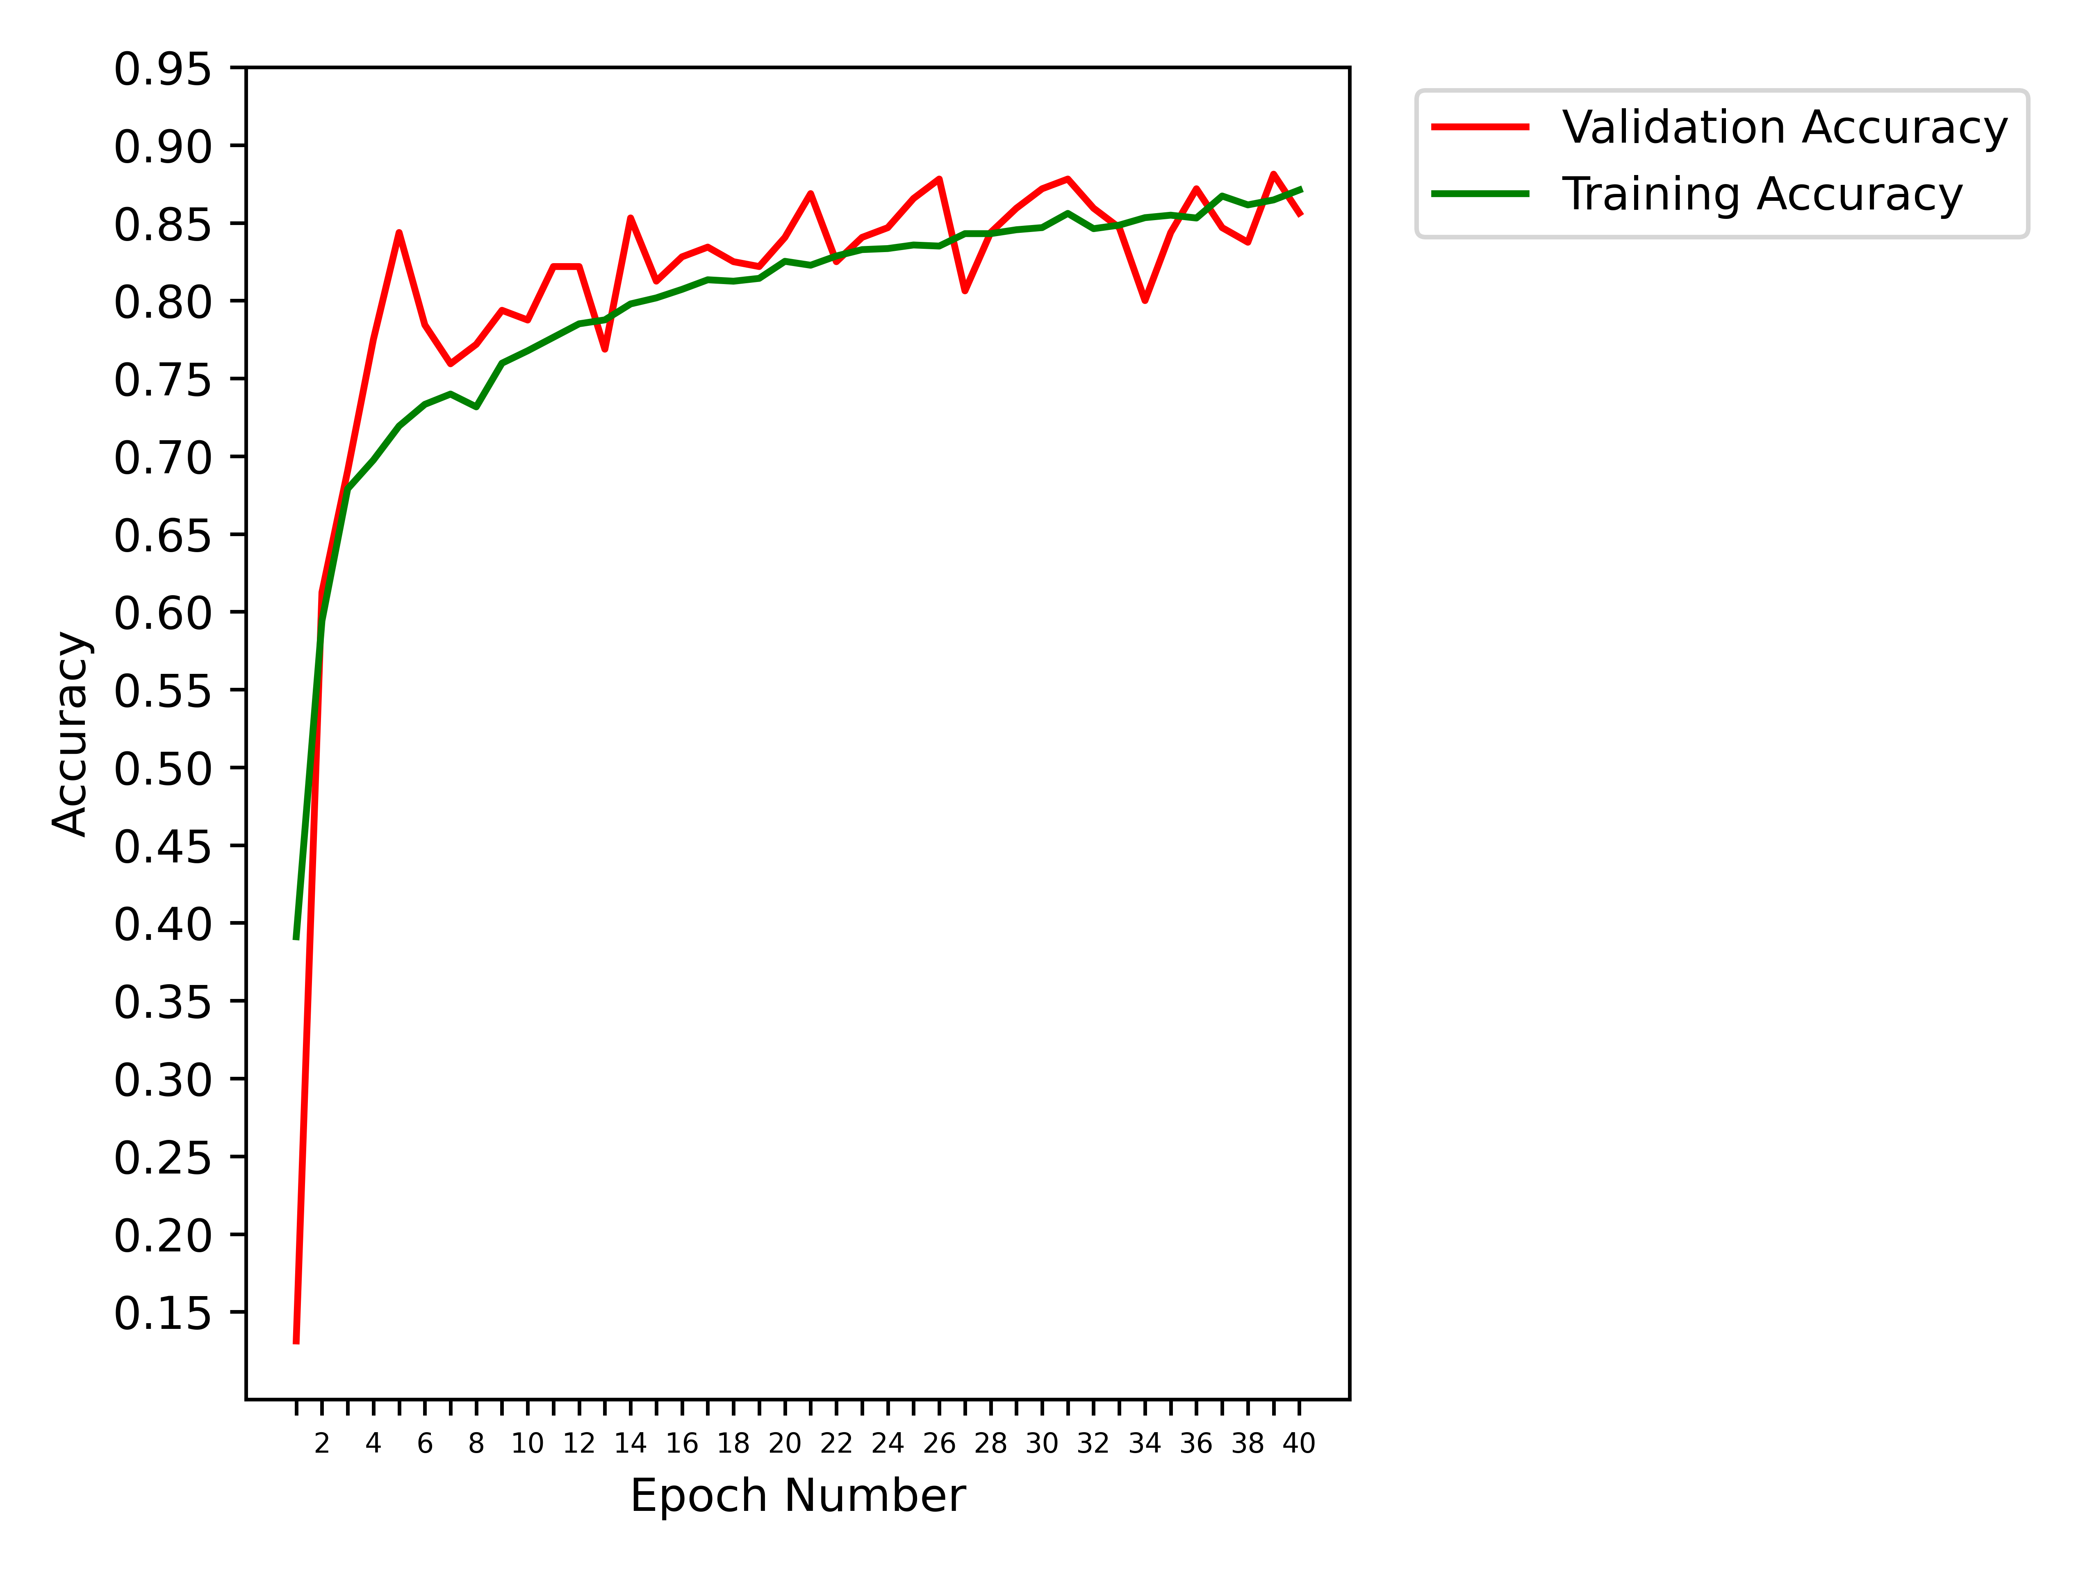
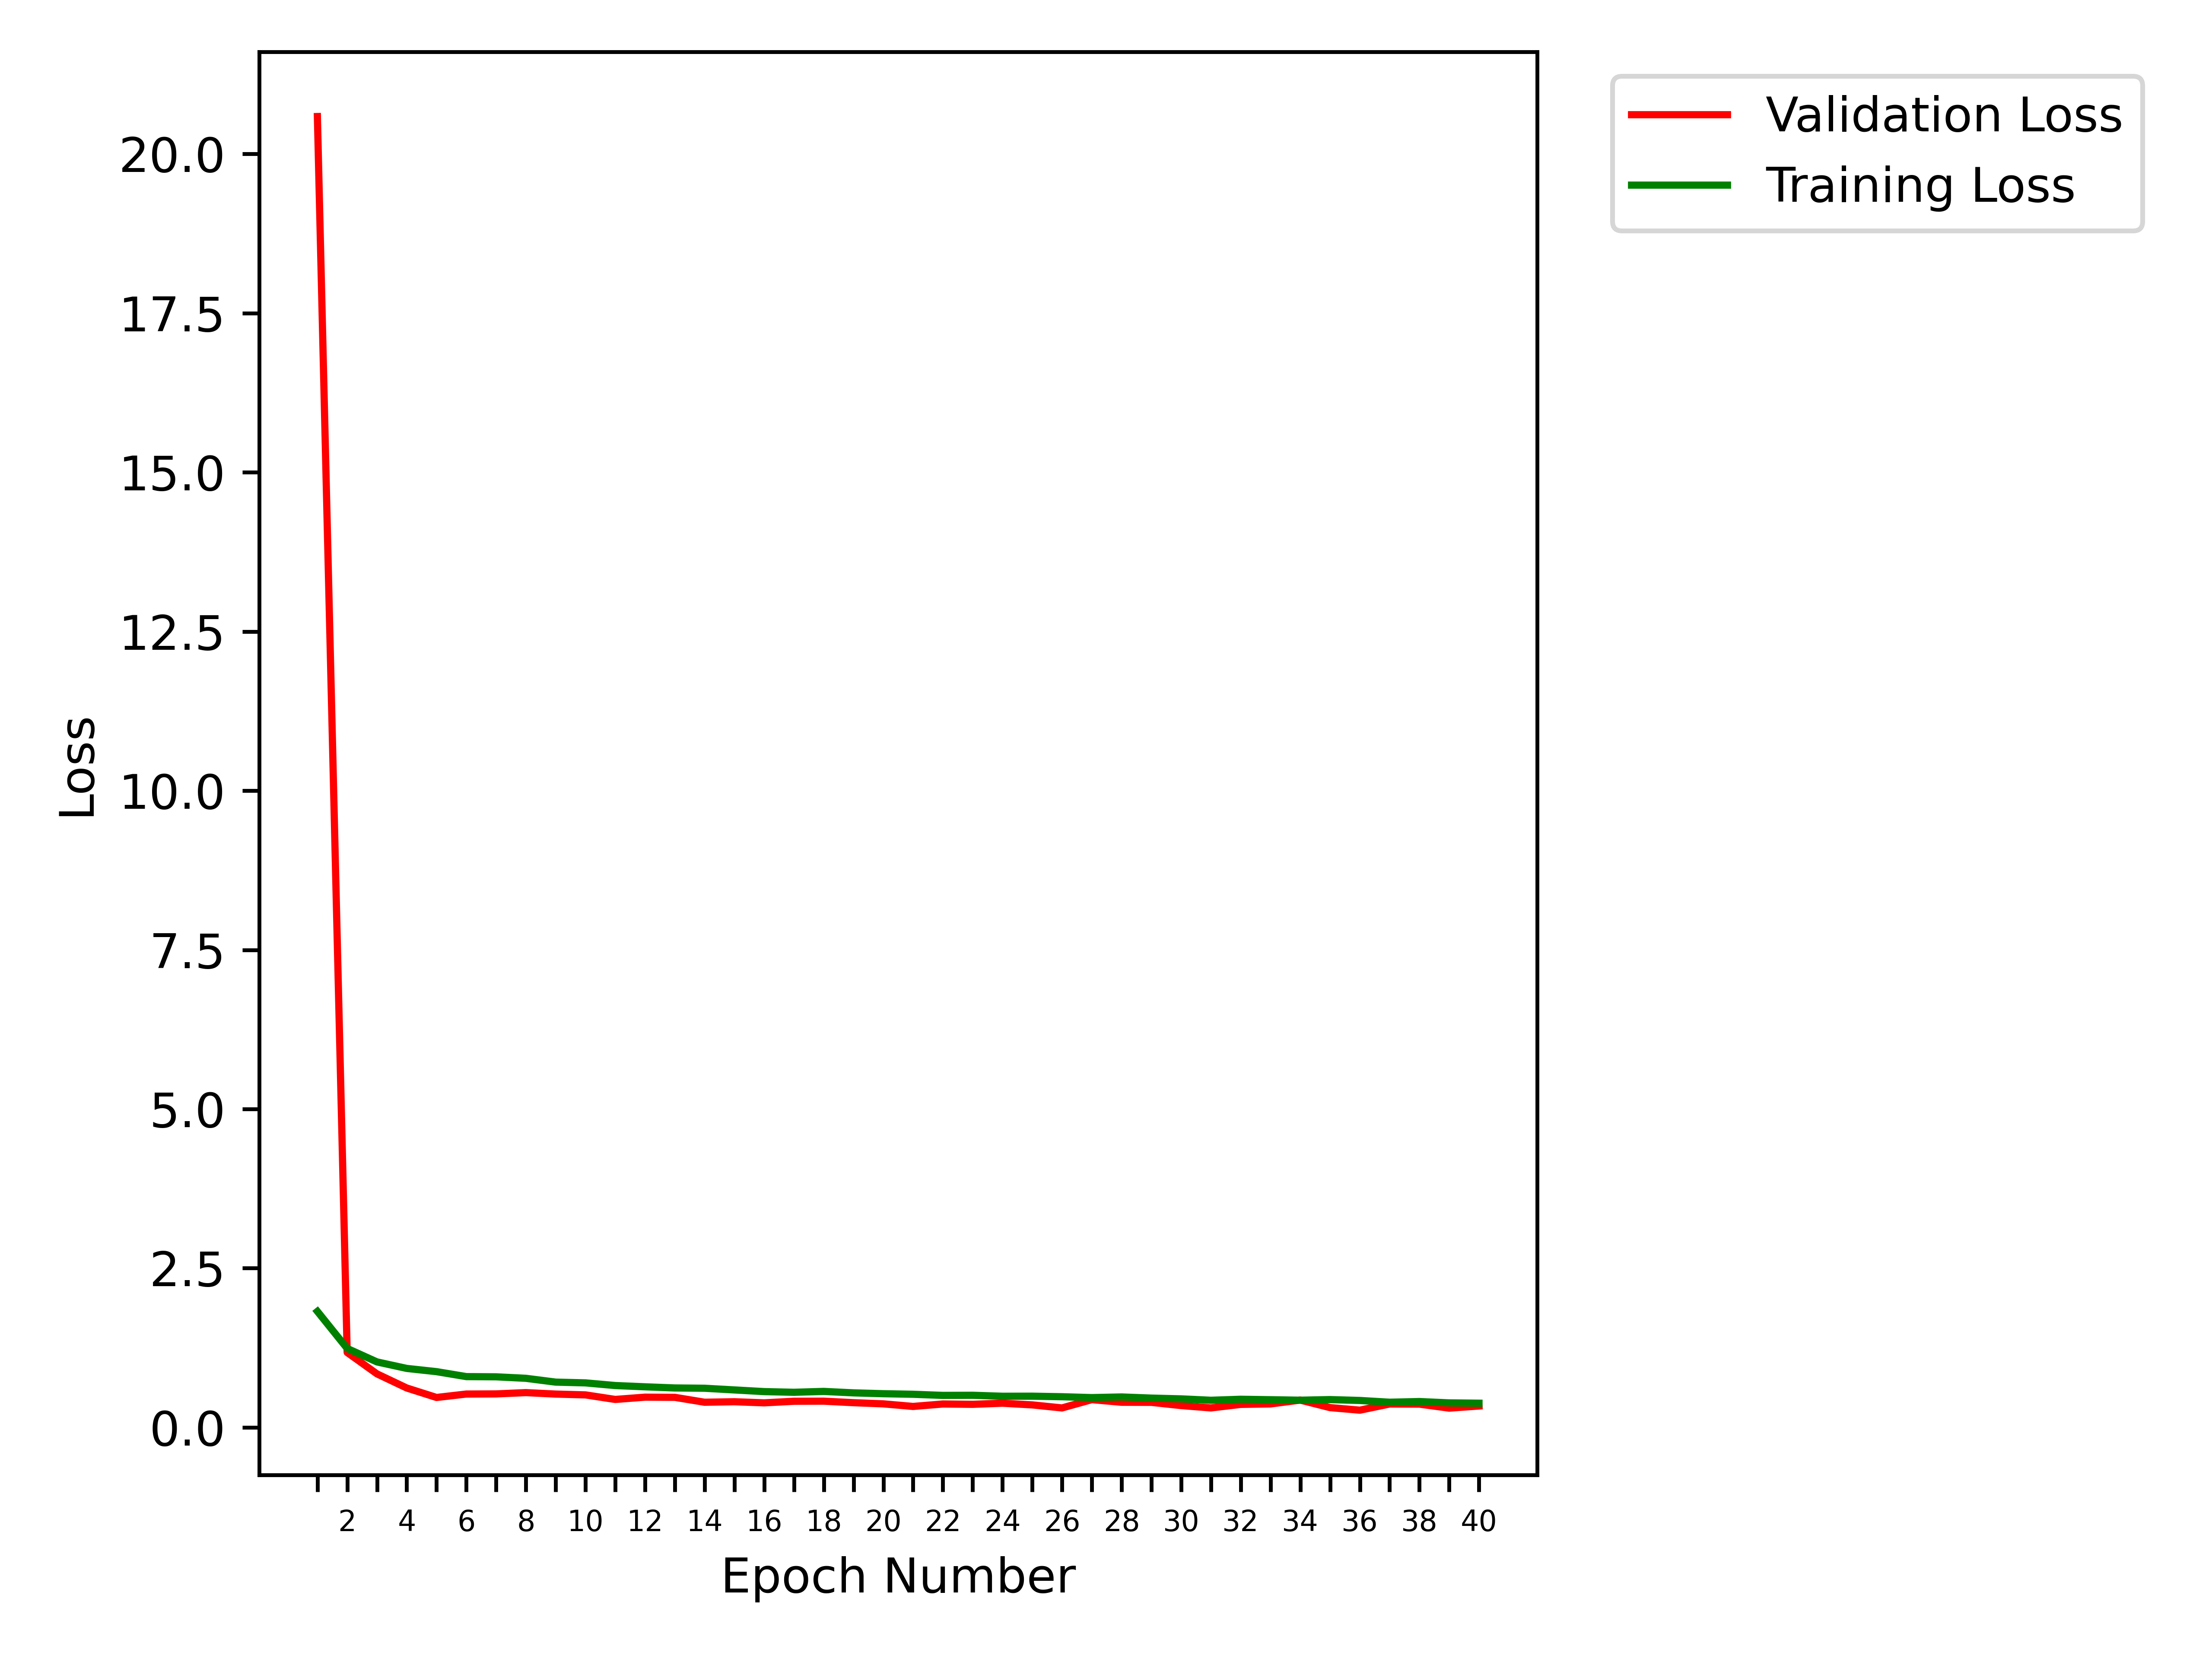
Obtained Results (6 classes)
40 epochs, SGD, no MAPGI, All Augmentations
Class | cecum | esophagitis | polyps | pylorus | ulcerative-colitis | z-line
cecum | 194 | 0 | 0 | 0 | 8 | 0
esophagitis | 0 | 99 | 0 | 1 | 0 | 33
polyps | 2 | 1 | 193 | 2 | 8 | 0
pylorus | 0 | 0 | 2 | 196 | 2 | 0
ulcerative-colitis | 14 | 0 | 8 | 0 | 149 | 0
z-line | 0 | 56 | 1 | 2 | 0 | 128

Slide 27
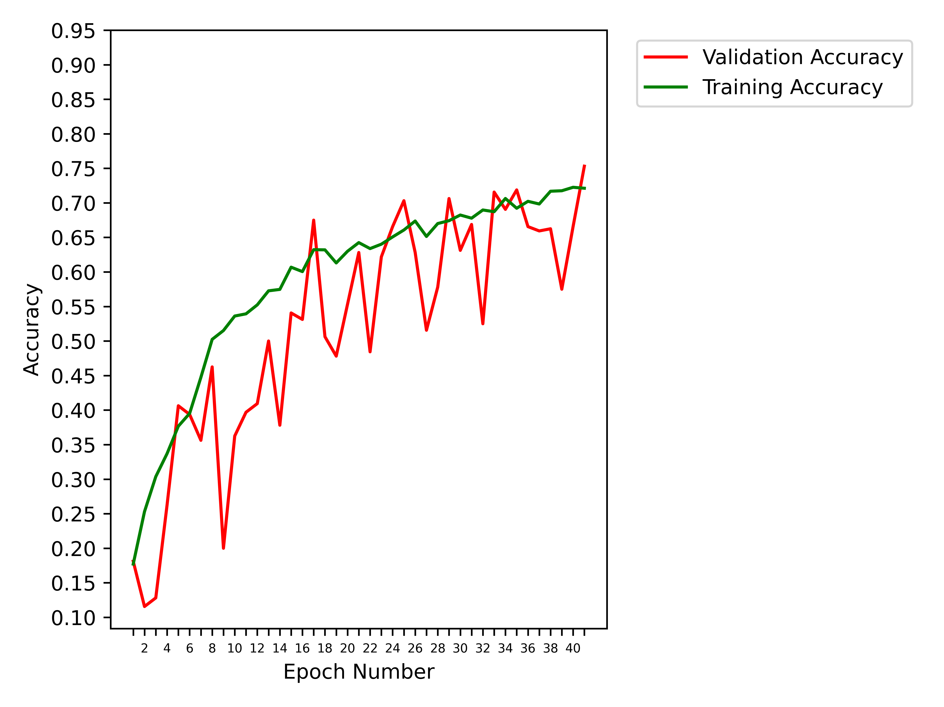

Obtained Results (6 classes)
41 epochs, RMSProp, no MAPGI, All Augmentations
Class | cecum | esophagitis | polyps | pylorus | ulcerative-colitis | z-line
cecum | 178 | 0 | 0 | 0 | 24 | 0
esophagitis | 0 | 95 | 0 | 2 | 2 | 34
polyps | 1 | 1 | 112 | 2 | 90 | 0
pylorus | 0 | 0 | 2 | 189 | 8 | 1
ulcerative-colitis | 9 | 0 | 13 | 7 | 142 | 0
z-line | 0 | 62 | 0 | 13 | 2 | 110

Slide 28
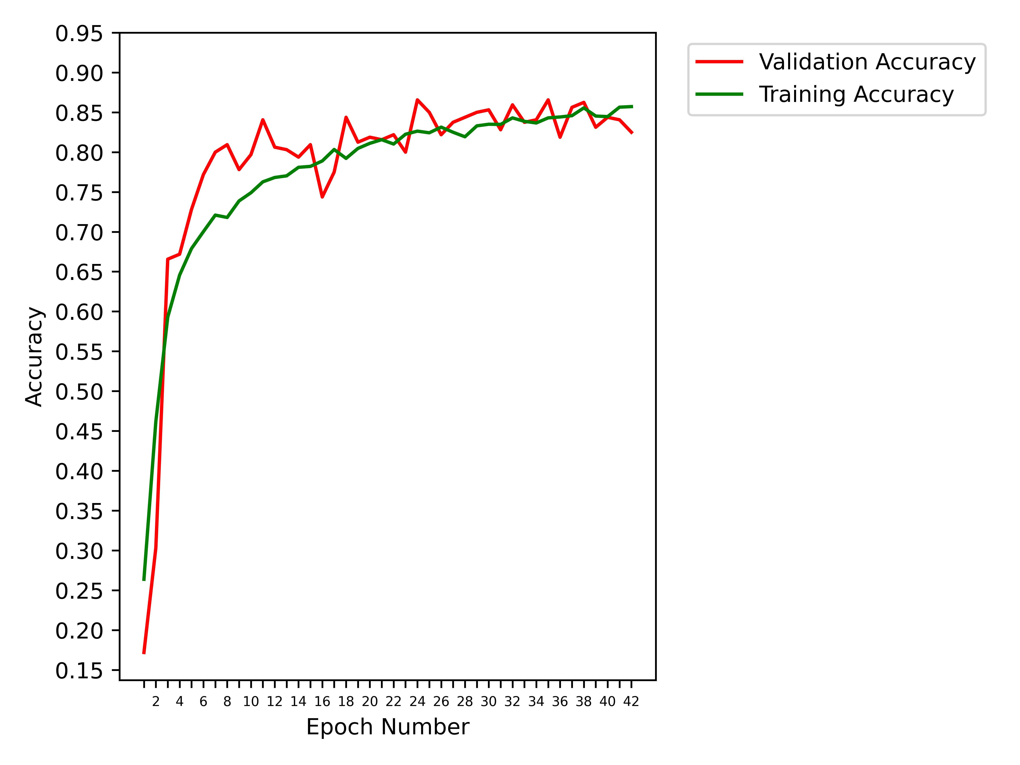
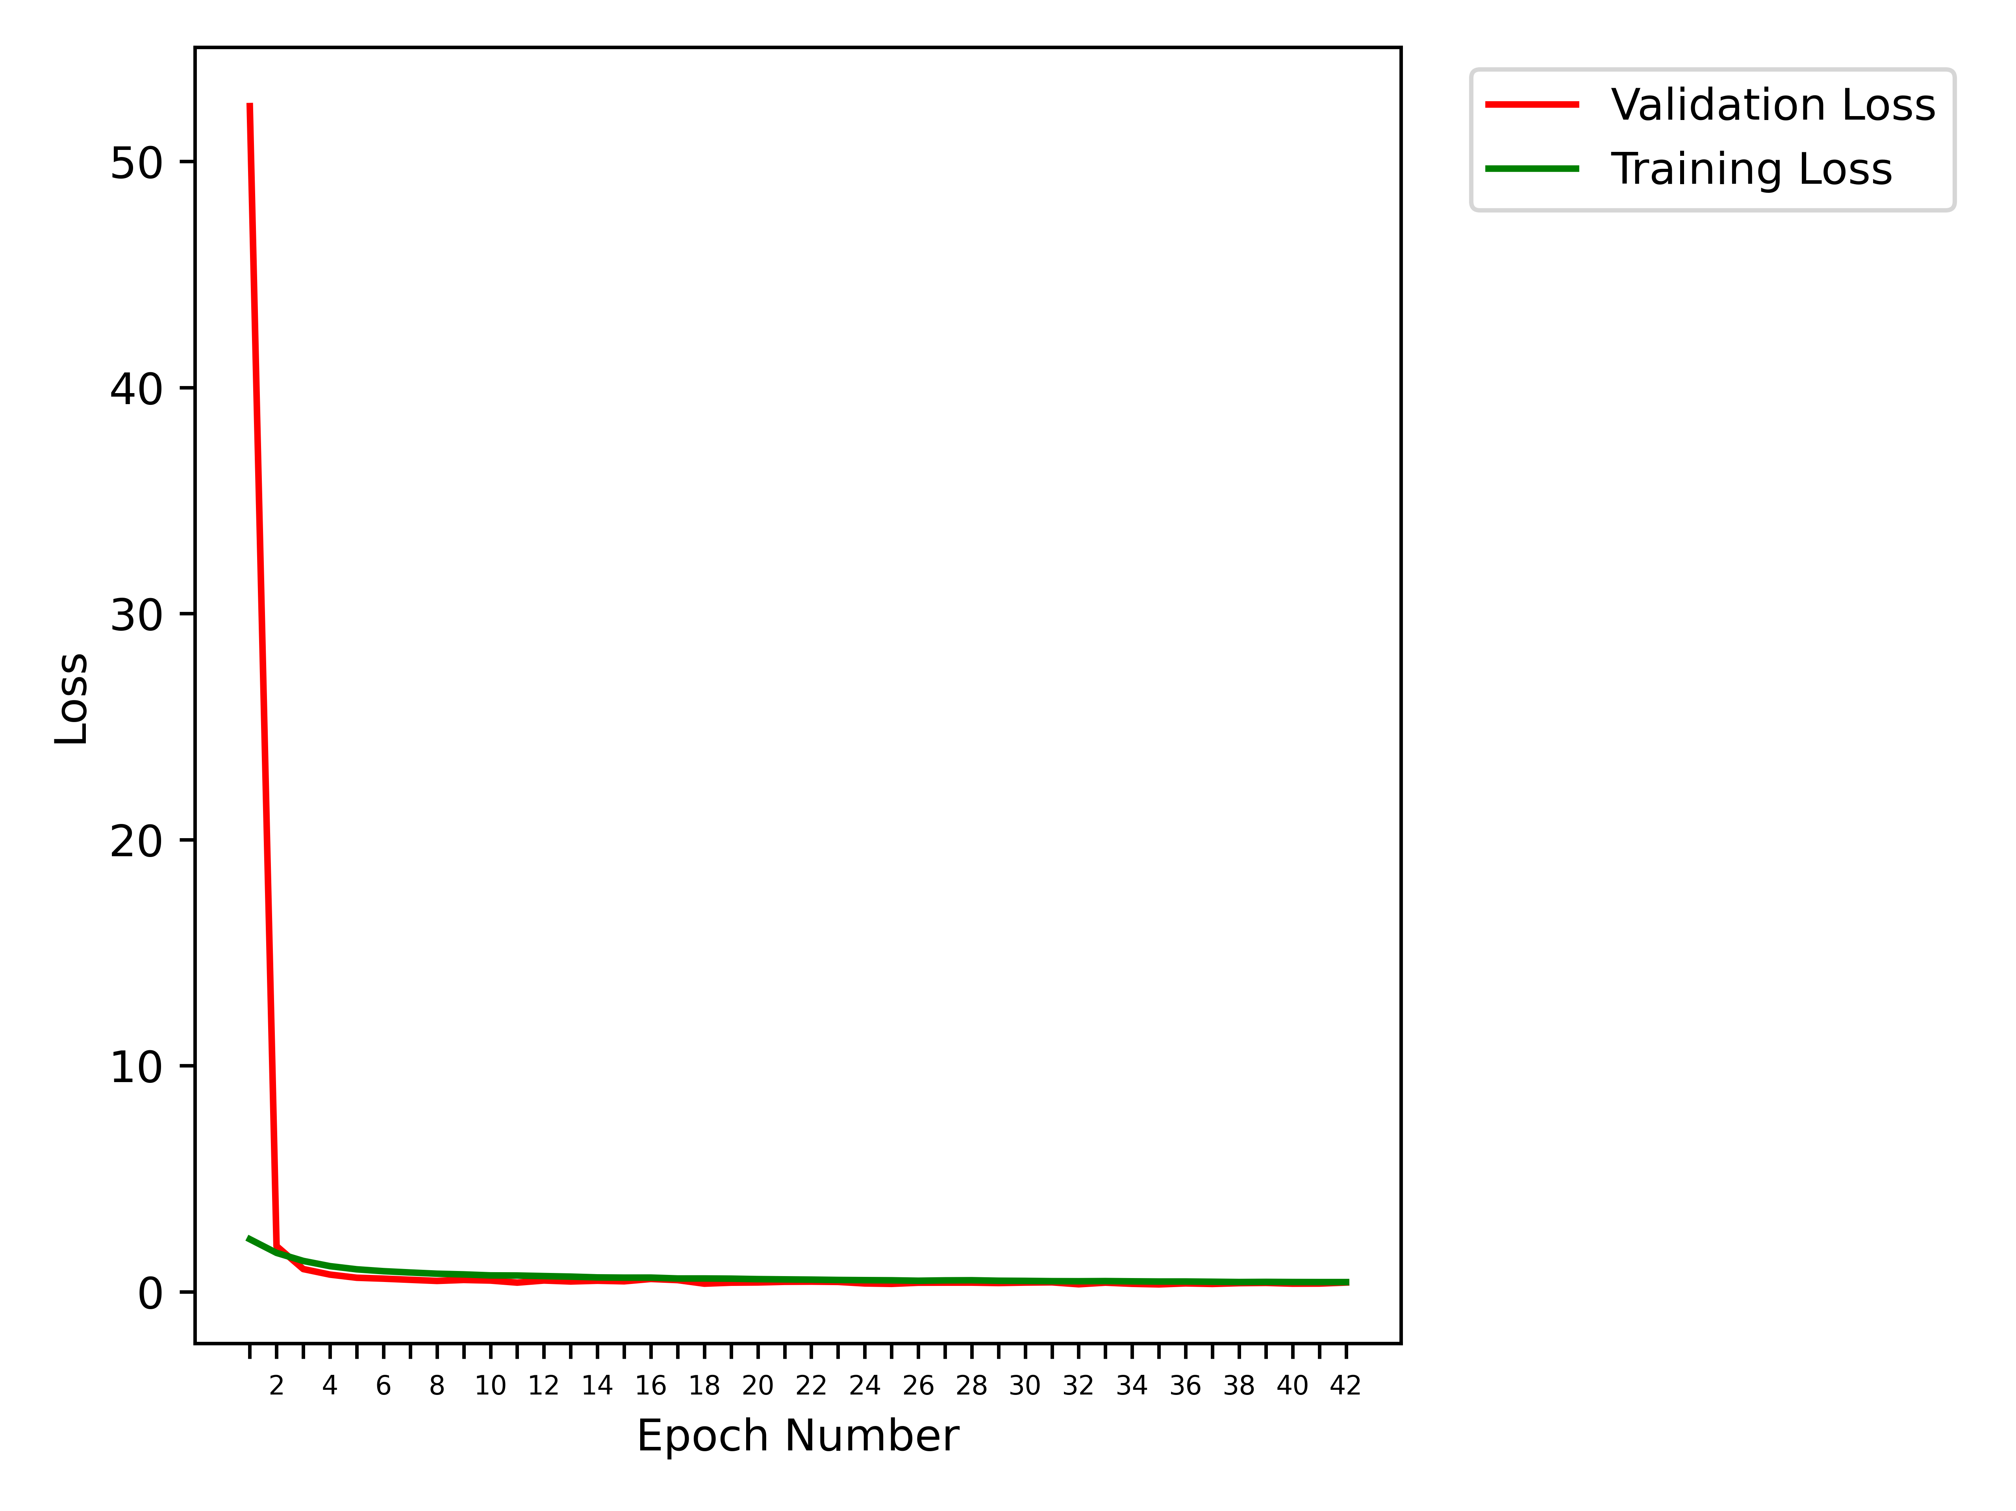
Obtained Results (6 classes)
42 epochs, SGD, MAPGI, All Augmentations
Class | cecum | esophagitis | polyps | pylorus | ulcerative-colitis | z-line
cecum | 188 | 0 | 3 | 0 | 11 | 0
esophagitis | 0 | 108 | 1 | 0 | 1 | 23
polyps | 2 | 0 | 192 | 2 | 10 | 0
pylorus | 0 | 2 | 7 | 189 | 2 | 0
ulcerative-colitis | 5 | 1 | 22 | 0 | 143 | 0
z-line | 0 | 67 | 0 | 3 | 0 | 117

Slide 29
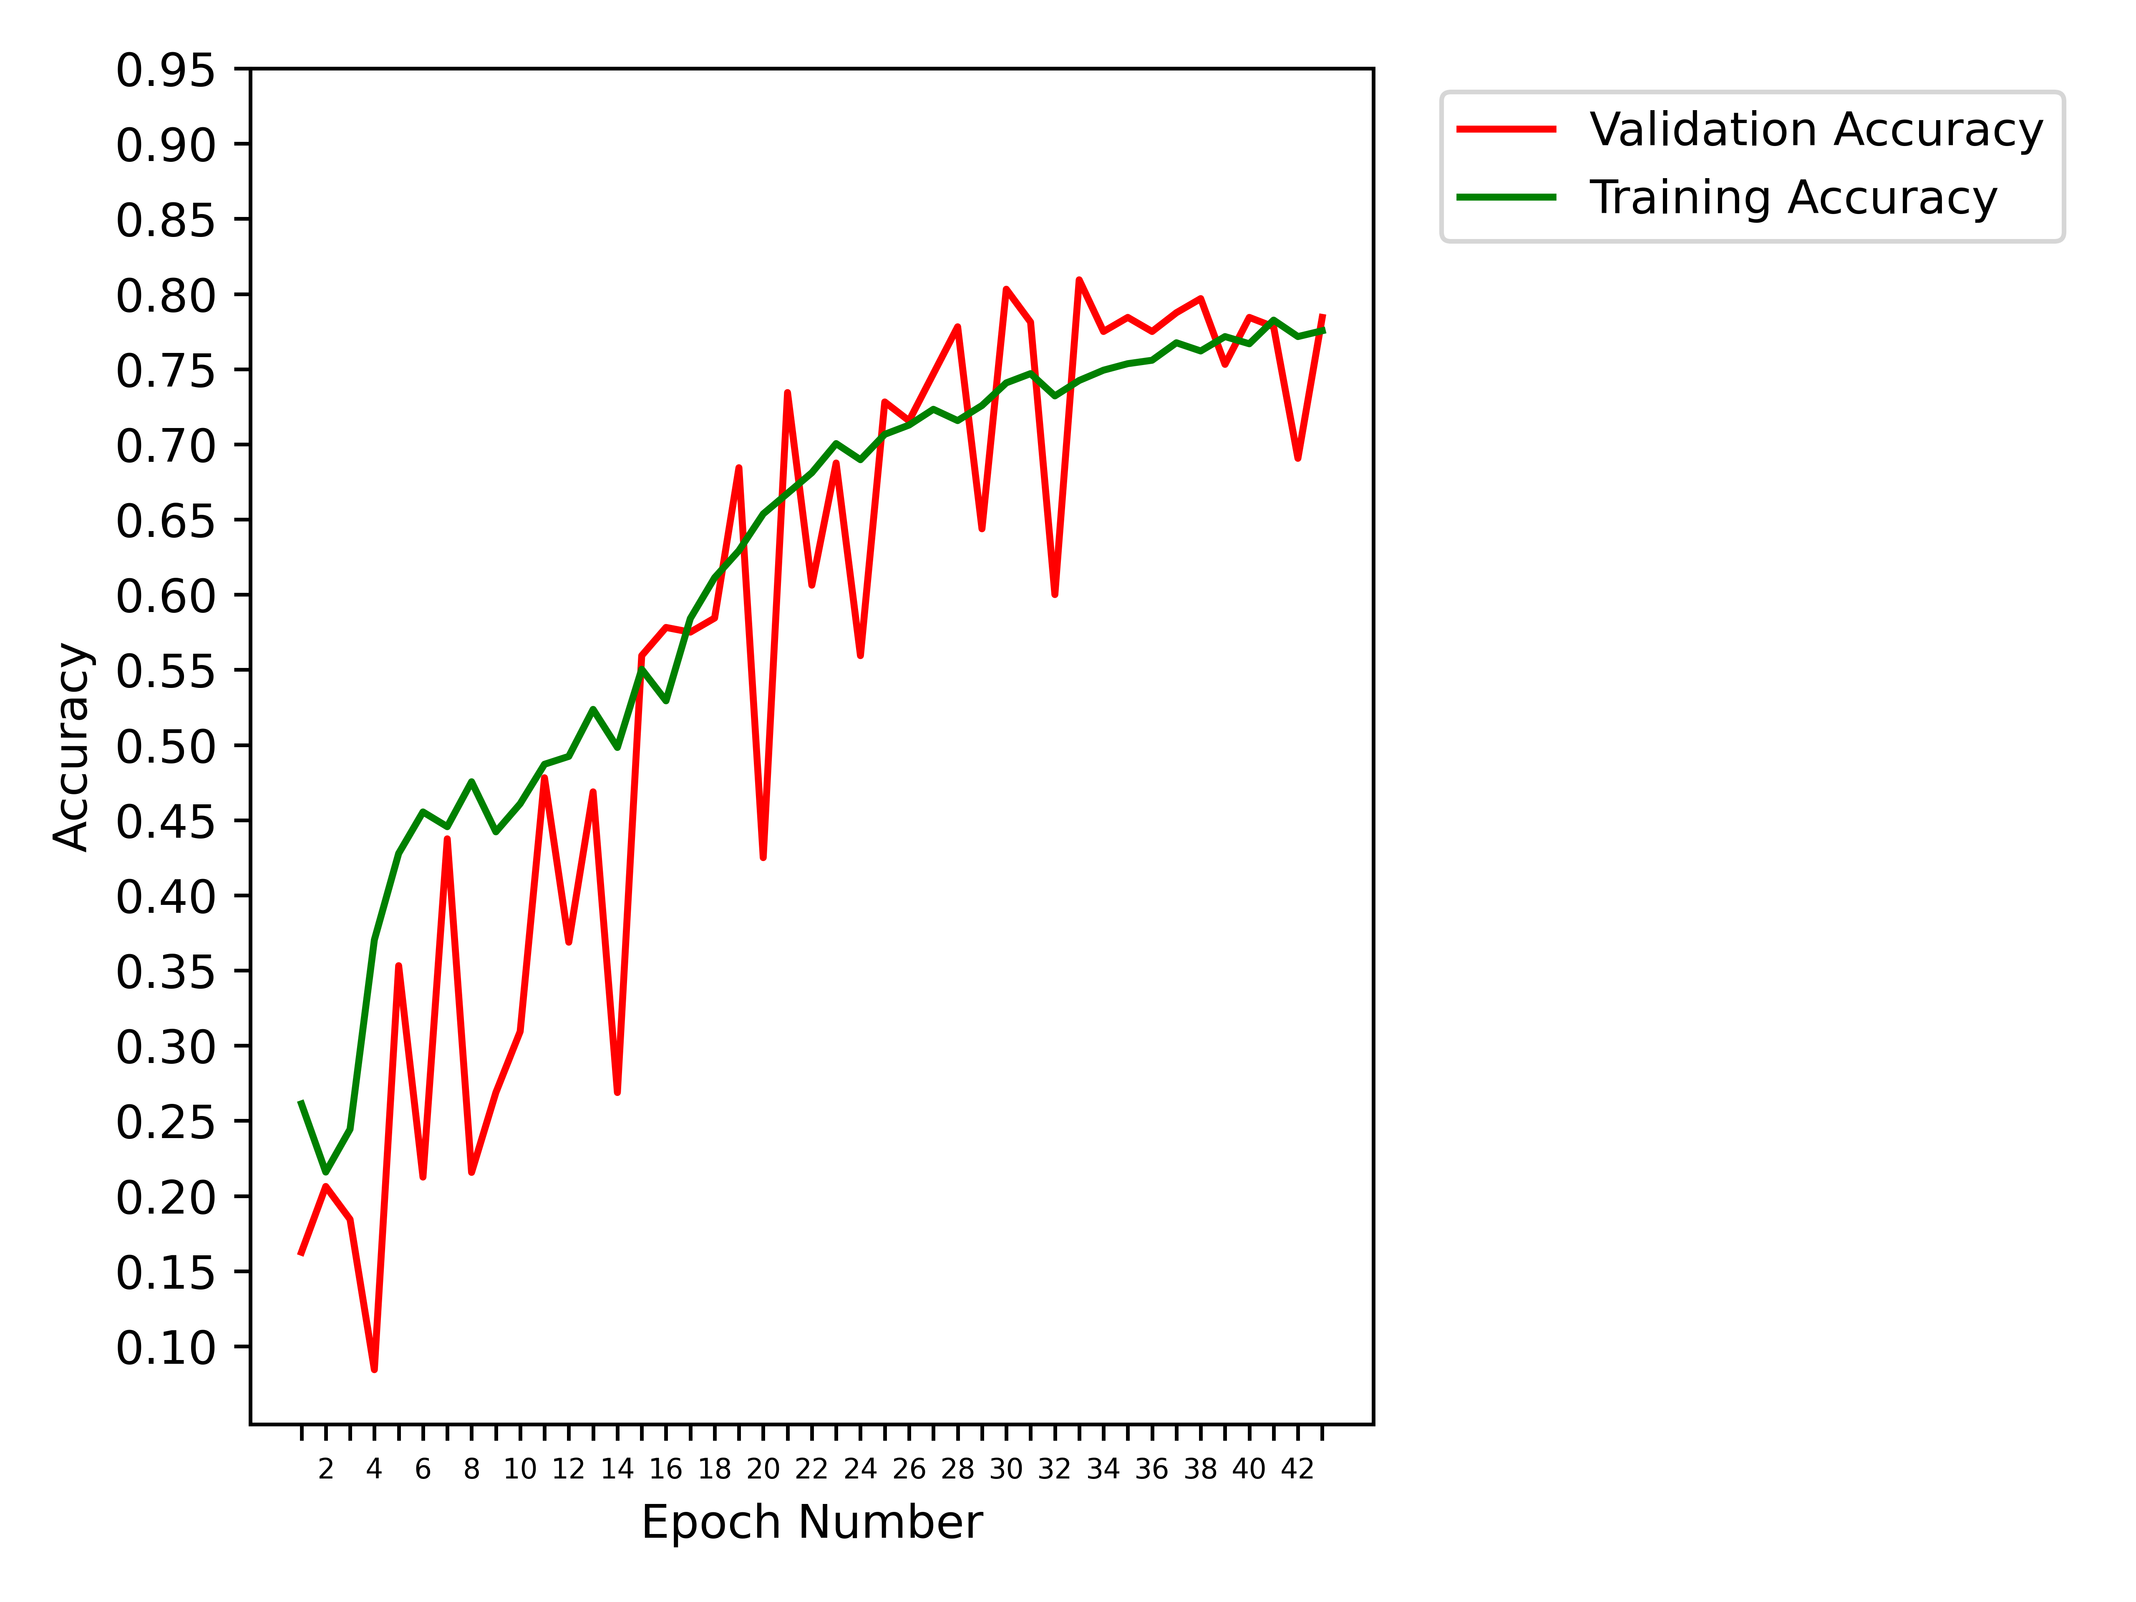
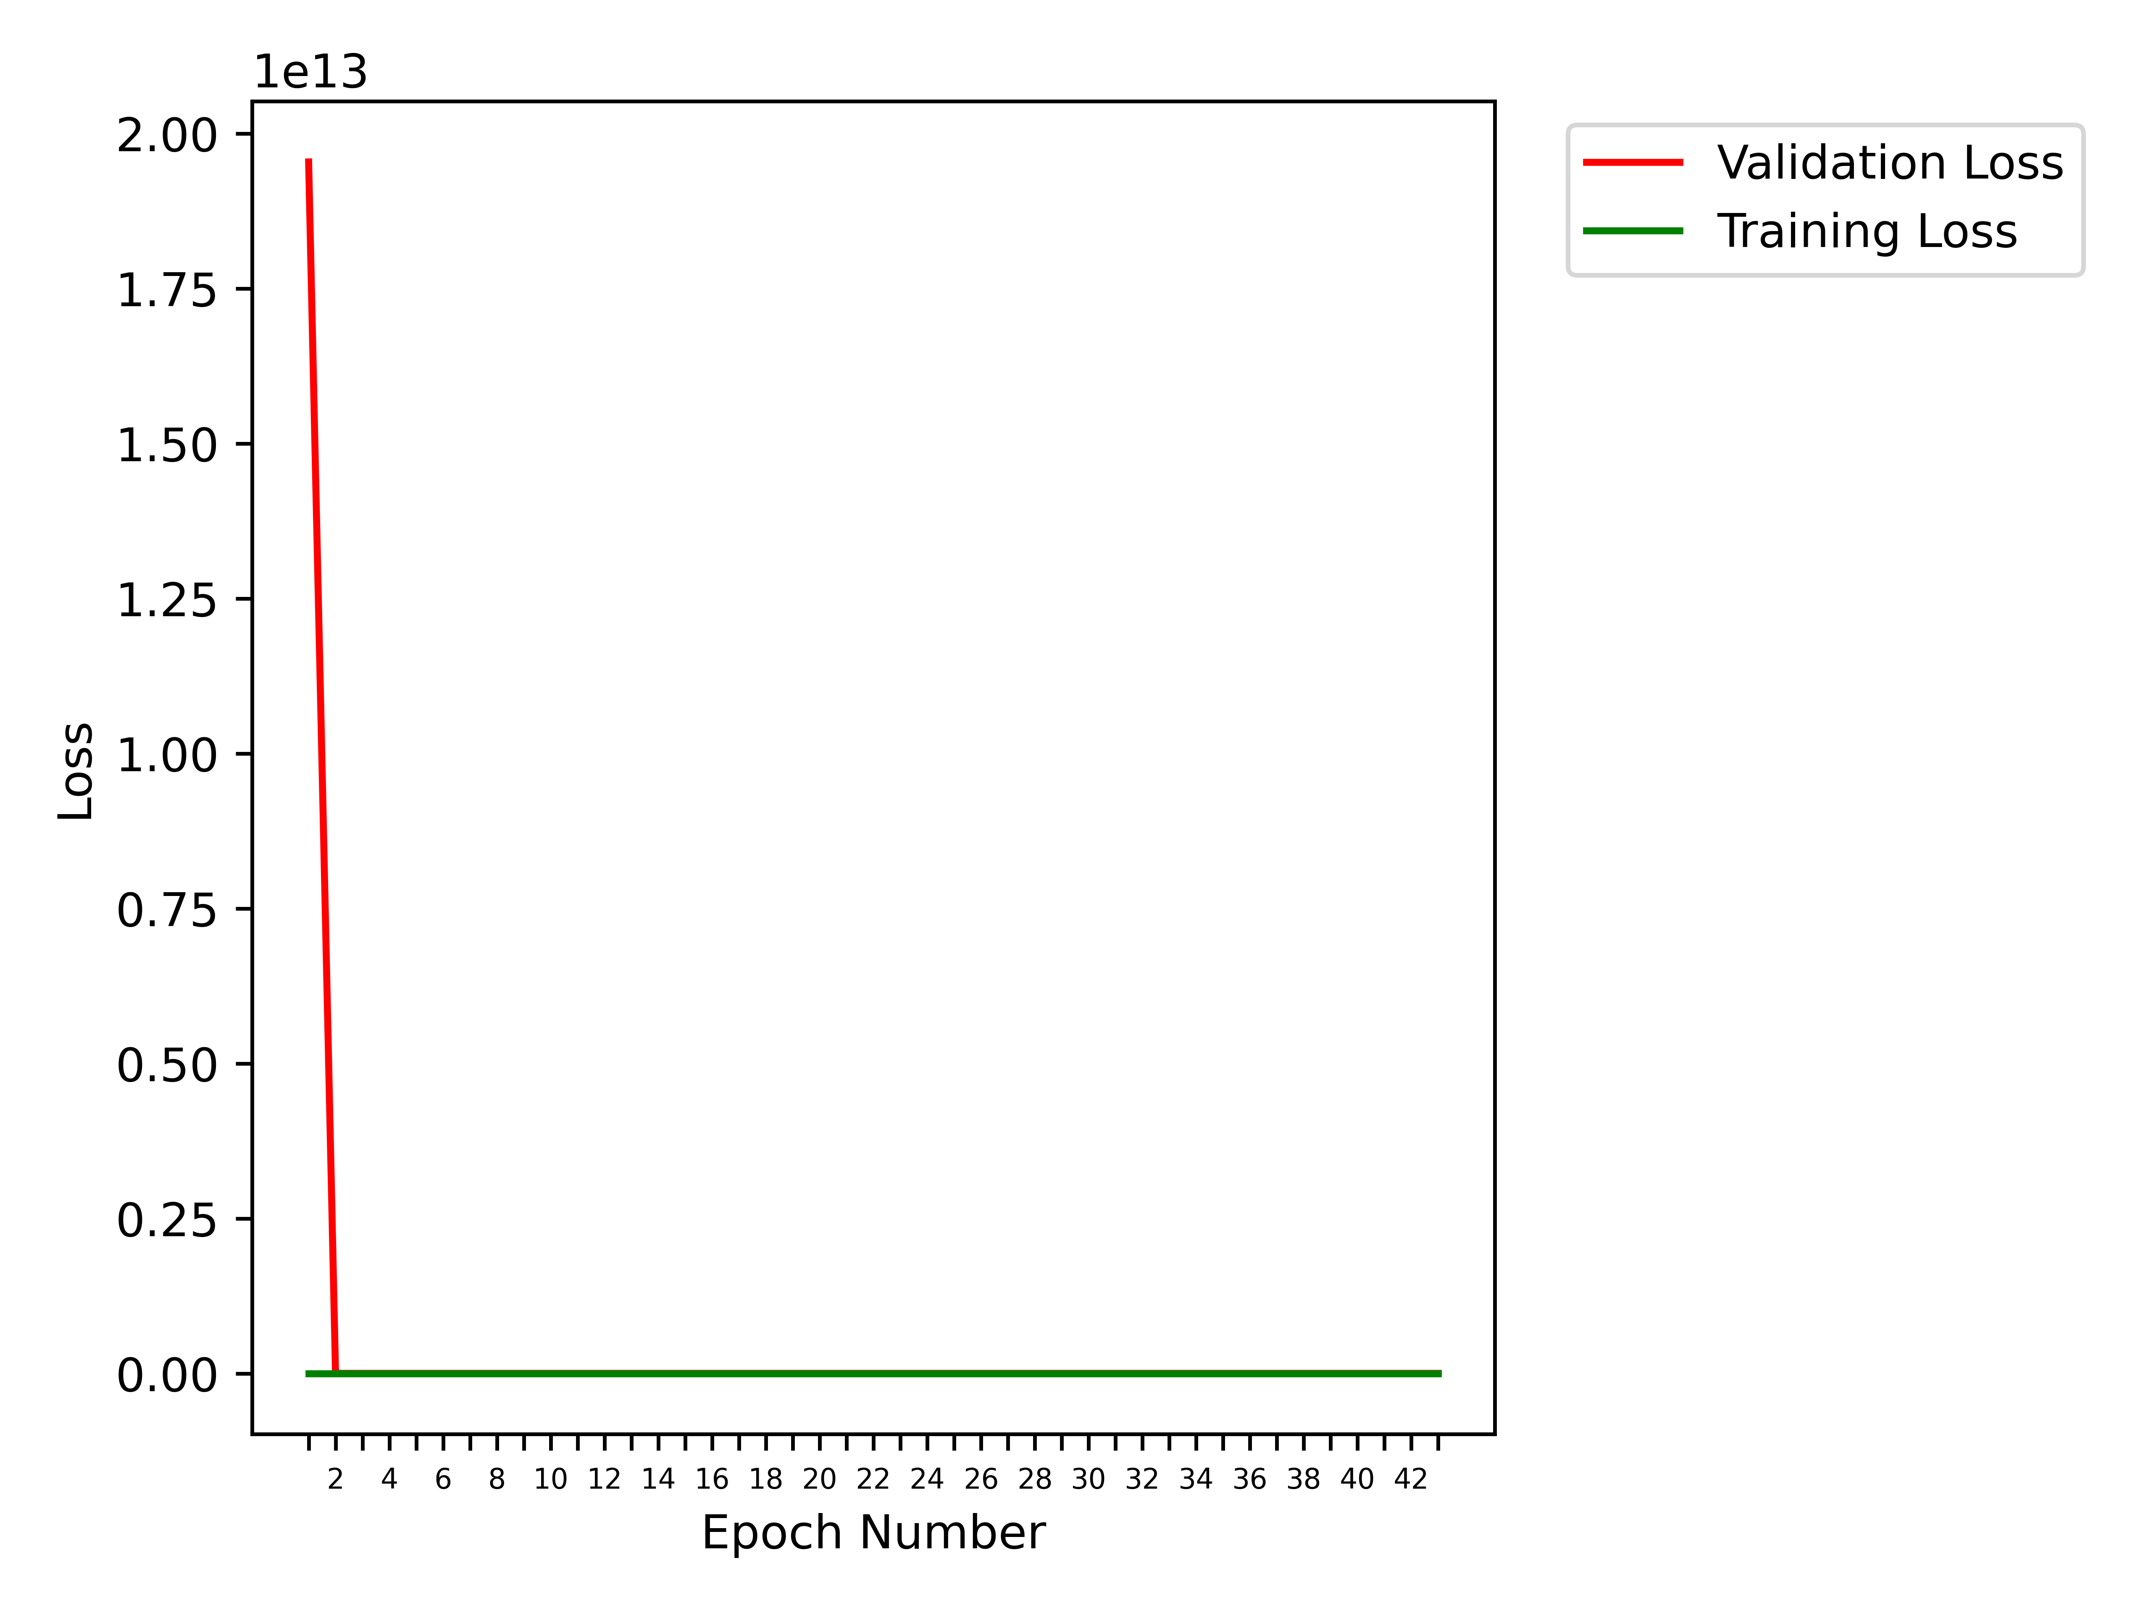
Obtained Results (6 classes)
43 epochs, RMSProp, MAPGI, All Augmentations
Class | cecum | esophagitis | polyps | pylorus | ulcerative-colitis | z-line
cecum | 193 | 0 | 2 | 0 | 7 | 0
esophagitis | 0 | 99 | 0 | 2 | 2 | 30
polyps | 1 | 1 | 194 | 2 | 8 | 0
pylorus | 0 | 1 | 5 | 183 | 9 | 2
ulcerative-colitis | 12 | 1 | 25 | 5 | 127 | 1
z-line | 0 | 55 | 0 | 6 | 1 | 125

Slide 30
Obtained Results (6 classes)
200 epochs, SGD, MAPGI, Only Mirroring Augmentation
Class | cecum | esophagitis | polyps | pylorus | ulcerative-colitis | z-line
cecum | 196 | 0 | 2 | 0 | 4 | 0
esophagitis | 0 | 92 | 0 | 0 | 0 | 41
polyps | 3 | 0 | 196 | 1 | 6 | 0
pylorus | 0 | 0 | 0 | 193 | 4 | 3
ulcerative-colitis | 14 | 0 | 2 | 1 | 154 | 0
z-line | 0 | 38 | 0 | 2 | 1 | 146

Slide 31
Obtained Results (6 classes)
201 epochs, SGD, no MAPGI, Only Mirroring Augmentation
Class | cecum | esophagitis | polyps | pylorus | ulcerative-colitis | z-line
cecum | 183 | 0 | 0 | 0 | 19 | 0
esophagitis | 0 | 109 | 0 | 1 | 0 | 23
polyps | 1 | 0 | 198 | 1 | 6 | 0
pylorus | 0 | 0 | 0 | 200 | 0 | 0
ulcerative-colitis | 2 | 0 | 3 | 3 | 163 | 0
z-line | 0 | 60 | 0 | 8 | 0 | 119

Slide 32
Obtained Results (6 classes)
300 epochs, SGD, no MAPGI, All Augmentations except samplewise std normalisation
Class | cecum | esophagitis | polyps | pylorus | ulcerative-colitis | z-line
cecum | 194 | 0 | 3 | 0 | 5 | 0
esophagitis | 0 | 99 | 0 | 1 | 0 | 33
polyps | 1 | 0 | 191 | 1 | 13 | 0
pylorus | 0 | 1 | 6 | 193 | 0 | 0
ulcerative-colitis | 10 | 0 | 11 | 0 | 150 | 0
z-line | 0 | 48 | 0 | 2 | 0 | 137

Slide 33
Obtained Results (6 classes)
301 epochs, SGD, MAPGI, All Augmentations except samplewise std normalisation
Class | cecum | esophagitis | polyps | pylorus | ulcerative-colitis | z-line
cecum | 181 | 0 | 0 | 0 | 21 | 0
esophagitis | 0 | 94 | 0 | 0 | 0 | 39
polyps | 1 | 0 | 189 | 4 | 11 | 1
pylorus | 0 | 1 | 0 | 198 | 1 | 0
ulcerative-colitis | 2 | 0 | 1 | 0 | 168 | 0
z-line | 0 | 43 | 0 | 3 | 0 | 141

Slide 34
Obtained Results (6 classes)
302 epochs, SGD, no MAPGI, All Augmentations
Class | cecum | esophagitis | polyps | pylorus | ulcerative-colitis | z-line
cecum | 198 | 0 | 0 | 0 | 4 | 0
esophagitis | 0 | 74 | 0 | 0 | 0 | 59
polyps | 1 | 0 | 193 | 1 | 11 | 0
pylorus | 0 | 0 | 3 | 195 | 2 | 0
ulcerative-colitis | 9 | 0 | 11 | 0 | 151 | 0
z-line | 0 | 15 | 0 | 3 | 0 | 169

Slide 35
Obtained Results (6 classes)
303 epochs, SGD, MAPGI, All Augmentations
Class | cecum | esophagitis | polyps | pylorus | ulcerative-colitis | z-line
cecum | 195 | 0 | 1 | 0 | 6 | 0
esophagitis | 0 | 96 | 0 | 0 | 0 | 37
polyps | 2 | 0 | 196 | 1 | 7 | 0
pylorus | 0 | 1 | 4 | 195 | 0 | 0
ulcerative-colitis | 2 | 0 | 11 | 0 | 158 | 0
z-line | 0 | 25 | 0 | 1 | 0 | 161

Slide 36
Conclusions
We are unable to cross 90% accuracy, unlike the 98.45% accuracy reported in the paper.
In both the 6-class model and the 8-class model, it is evident from the confusion matrices that the primary classes that the network confuses are esophagitis and z-line. This is understandable because these two classes contain images of the same anatomical location, which in one case are diseased, and the other case healthy. The authors of the paper also encountered this issue, although we obtained a higher false negative rate for esophagitis (~25%) than the authors (~10%).
We obtain a frame rate of roughly 20 frames per second, when the prediction code was run on distinct image files in a directory, tested on the NVIDIA GeForce GTX 1080 Ti.
The use of MAPGI pre-processing technique did not yield a higher accuracy, as seen from the confusion matrices shown for both the 6-class and the 8-class models. Additionally, MAPGI slowed the per-epoch training time from 60-70 seconds to 90-100 seconds (nearly a 50% increase). The prediction speed dropped from 20 fps to 16 fps (a 20% slowdown).
The code used in this review can be found here.

Slide 37
In many of the latter test cases, the validation accuracy varies wildly between epochs, by more than 10% at times. We need a more stable model. We will start by listing the peak validation accuracy obtained. In our second attempt, we will not match the peak, but we will obtain a better, more versatile model.
40 epochs (8 classes) - 84%
42 epochs (8 classes) - 84.5%
40 epochs - 88%
42 epochs - 86.5
200 epochs - 93%
201 epochs - 93.5%
300 epochs - 92%
301 epochs - 92%
302 epochs - 92%
303 epochs - 92.3%

Slide 38
Second Attempt
For our renewed attempt, we have considered regularisation (kernel, activity and weights) and a pretrained Inceptionv3 model with a dense layer at the end of it before the final output layer (with a Dropout of 0.2). For different cases, we have taken zero or more layers of the inceptionv3 model as trainable. We have tried varying L2 regularisation parameter and learning rate. Finally, we have repeated most of our experiments with the EfficientNetB7 model, as discussed in the Quality Assessment PPT, to compare various networks.
We have stopped trying to vary image augmentation techniques and used all augmentations.
We are using the SGD optimiser, since the RMS optimiser had a poor accuracy in the previous attempt.
We are using only six classes.
We also added code to better create confusion matrices, and also yield metrics such as F1 score, precision, recall, etc.

Slide 39
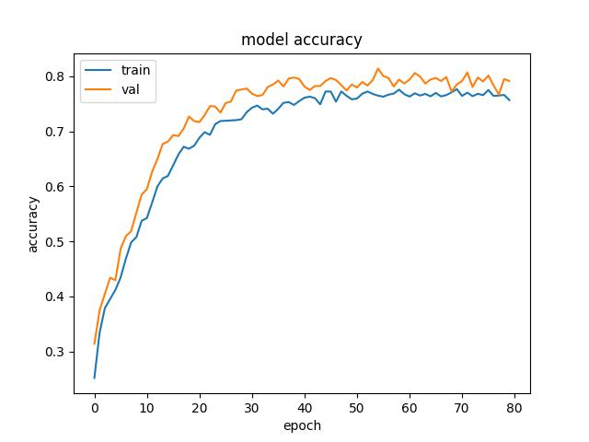
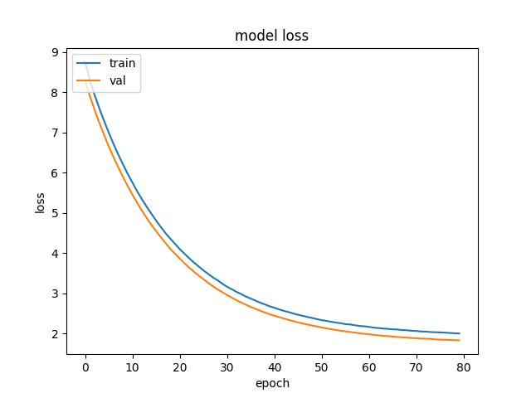
80 epochs , 0.2 dropout , 0.001 learning rate, 0.1 L2 regularisation, MAPGI disabled, Inceptionv3, 1 trainable layer

Slide 40
80 epochs , 0.2 dropout , 0.001 learning rate, 0.1 L2 regularisation, MAPGI disabled, Inceptionv3, 1 trainable layer
Class | cecum | esophagitis | polyps | pylorus | ulcerative-colitis | z-line
cecum | 182 | 0 | 16 | 2 | 2 | 0
esophagitis | 0 | 92 | 0 | 16 | 1 | 24
polyps | 3 | 0 | 198 | 3 | 2 | 0
pylorus | 0 | 3 | 1 | 193 | 2 | 1
ulcerative-colitis | 12 | 0 | 28 | 0 | 130 | 1
z-line | 0 | 98 | 1 | 28 | 0 | 60
Precision = 77.6 Accuracy = 92.6 Recall (Sensitivity) = 76.67 Specificity = 95.61 F1 score = 75.23

Slide 41
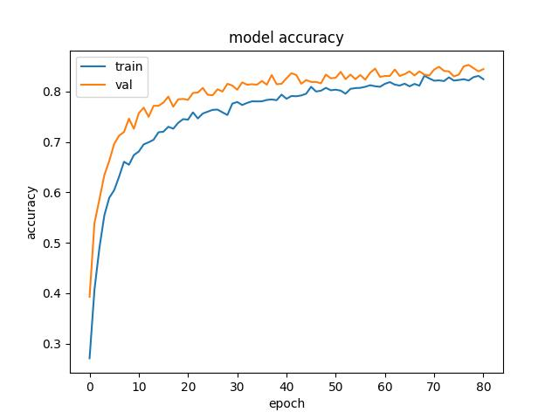
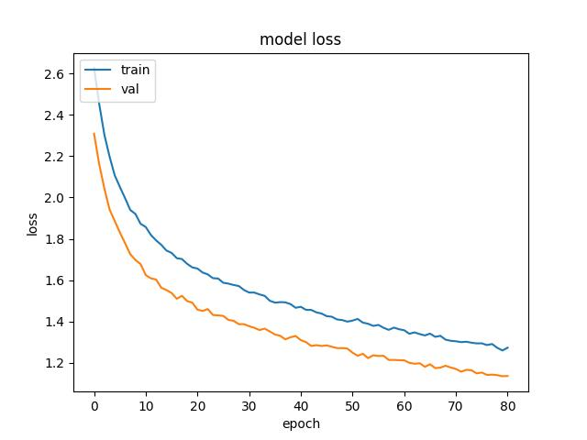
81 epochs , 0.2 dropout , 0.001 learning rate, 0.01 L2 regularisation, MAPGI disabled, Inceptionv3, 2 trainable layers

Slide 42
81 epochs , 0.2 dropout , 0.001 learning rate, 0.01 L2 regularisation, MAPGI disabled, Inceptionv3, 2 trainable layers
Class | cecum | esophagitis | polyps | pylorus | ulcerative-colitis | z-line
cecum | 188 | 0 | 9 | 2 | 3 | 0
esophagitis | 0 | 69 | 0 | 12 | 2 | 50
polyps | 1 | 0 | 199 | 4 | 2 | 0
pylorus | 0 | 2 | 1 | 192 | 2 | 3
ulcerative-colitis | 7 | 0 | 17 | 1 | 145 | 1
z-line | 0 | 36 | 0 | 29 | 0 | 122
Precision = 81.99 Accuracy = 94.42 Recall (Sensitivity) = 81.26 Specificity = 96.65 F1 score = 81.3

Slide 43
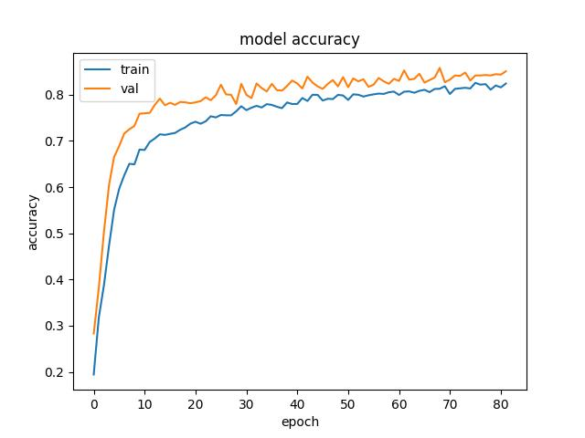
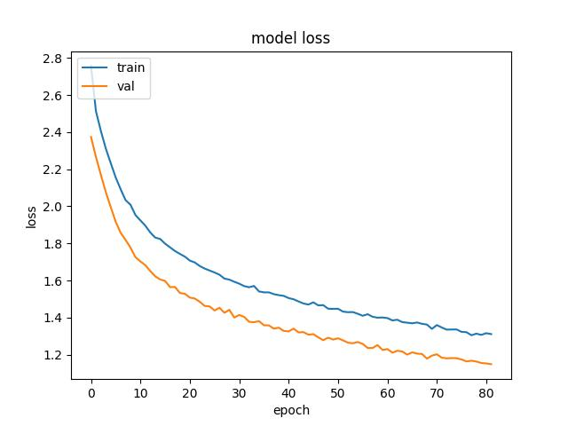
82 epochs , 0.2 dropout , 0.001 learning rate, 0.01 L2 regularisation, MAPGI disabled, Inceptionv3, 0 trainable layers

Slide 44
82 epochs , 0.2 dropout , 0.001 learning rate, 0.01 L2 regularisation, MAPGI disabled, Inceptionv3, 0 trainable layers
Class | cecum | esophagitis | polyps | pylorus | ulcerative-colitis | z-line
cecum | 186 | 0 | 13 | 2 | 1 | 0
esophagitis | 0 | 75 | 0 | 13 | 1 | 44
polyps | 3 | 0 | 198 | 3 | 2 | 0
pylorus | 0 | 3 | 1 | 193 | 1 | 2
ulcerative-colitis | 11 | 1 | 23 | 1 | 135 | 0
z-line | 0 | 32 | 1 | 28 | 0 | 126
Precision = 82.43 Accuracy = 94.36 Recall (Sensitivity) = 81.24 Specificity = 96.61 F1 score = 81.39

Slide 45
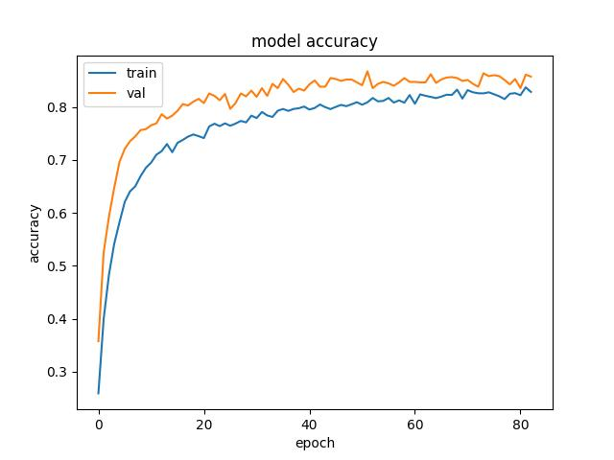
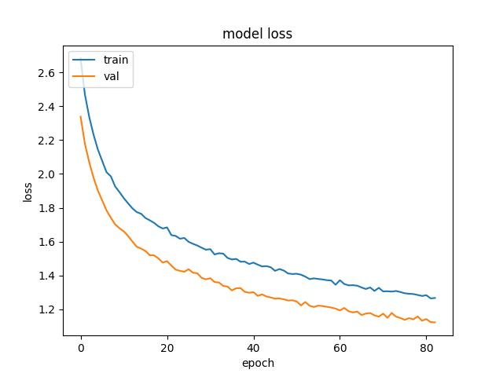
83 epochs , 0.2 dropout , 0.001 learning rate, 0.01 L2 regularisation, MAPGI enabled, Inceptionv3, 0 trainable layers

Slide 46
83 epochs , 0.2 dropout , 0.001 learning rate, 0.01 L2 regularisation, MAPGI enabled, Inceptionv3, 0 trainable layers
Class | cecum | esophagitis | polyps | pylorus | ulcerative-colitis | z-line
cecum | 191 | 0 | 5 | 1 | 5 | 0
esophagitis | 0 | 68 | 0 | 9 | 0 | 56
polyps | 5 | 0 | 184 | 7 | 10 | 0
pylorus | 1 | 1 | 3 | 186 | 0 | 9
ulcerative-colitis | 10 | 1 | 12 | 1 | 147 | 0
z-line | 0 | 14 | 0 | 12 | 0 | 161
Precision = 85.25 Accuracy = 95.09 Recall (Sensitivity) = 83.34 Specificity = 97.04 F1 score = 83.58

Slide 47
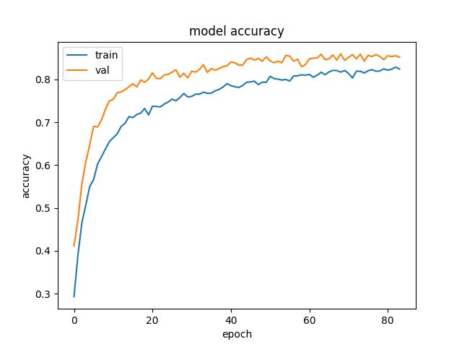
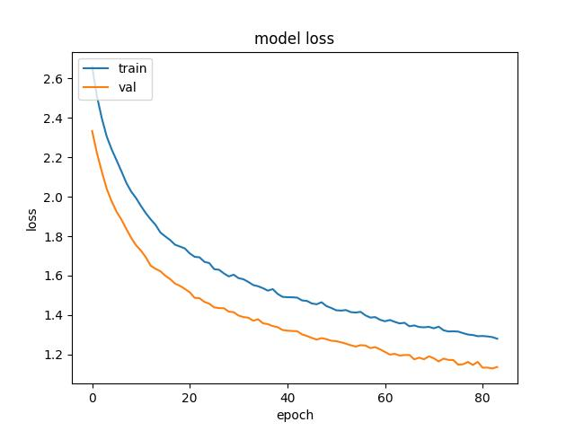
84 epochs , 0.2 dropout , 0.001 learning rate, 0.01 L2 regularisation, MAPGI enabled, Inceptionv3, 1 trainable layer

Slide 48
84 epochs , 0.2 dropout , 0.001 learning rate, 0.01 L2 regularisation, MAPGI enabled, Inceptionv3, 1 trainable layer
Class | cecum | esophagitis | polyps | pylorus | ulcerative-colitis | z-line
cecum | 189 | 0 | 6 | 1 | 6 | 0
esophagitis | 0 | 73 | 0 | 10 | 0 | 50
polyps | 6 | 0 | 185 | 6 | 9 | 0
pylorus | 0 | 3 | 3 | 188 | 0 | 6
ulcerative-colitis | 8 | 2 | 11 | 2 | 148 | 0
z-line | 0 | 13 | 0 | 15 | 0 | 159
Precision = 85.5 Accuracy = 95.24 Recall (Sensitivity) = 83.97 Specificity = 97.13 F1 score = 84.23

Slide 49
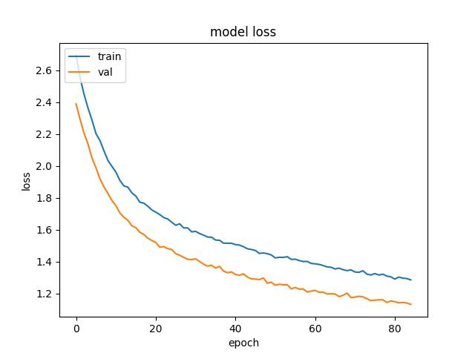
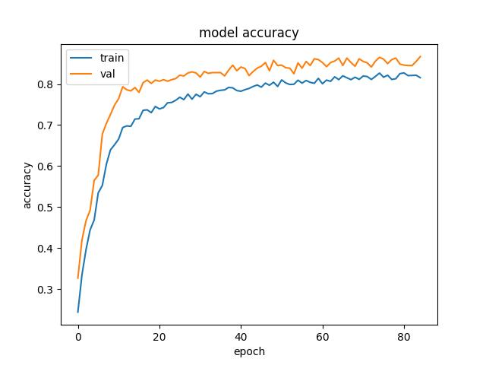
85 epochs , 0.2 dropout , 0.001 learning rate, 0.01 L2 regularisation, MAPGI enabled, Inceptionv3, 2 trainable layers

Slide 50
85 epochs , 0.2 dropout , 0.001 learning rate, 0.01 L2 regularisation, MAPGI enabled, Inceptionv3, 2 trainable layers
Class | cecum | esophagitis | polyps | pylorus | ulcerative-colitis | z-line
cecum | 192 | 0 | 5 | 0 | 5 | 0
esophagitis | 0 | 73 | 0 | 8 | 0 | 52
polyps | 4 | 0 | 189 | 6 | 7 | 0
pylorus | 0 | 2 | 2 | 186 | 0 | 10
ulcerative-colitis | 8 | 1 | 13 | 2 | 147 | 0
z-line | 0 | 15 | 0 | 9 | 0 | 163
Precision = 86.3 Accuracy = 95.48 Recall (Sensitivity) = 84.64 Specificity = 97.28 F1 score = 84.93

Slide 51
Analysis of 80-85 epochs cases
80-85 epochs cases demonstrate that we need to lower our L2 parameter since it is hamstringing the train accuracy and val accuracy due to high penalty and also because the Hyper Kvasir dataset is extensive and more resistant to overfitting.
We also need to use 0 trainable layers (except for the Dense/ Fully Connected Layer at the end).
Finally, we need to setup a learning rate schedule across a much greater number of epochs to allow for slow, steady and effective learning

Slide 52
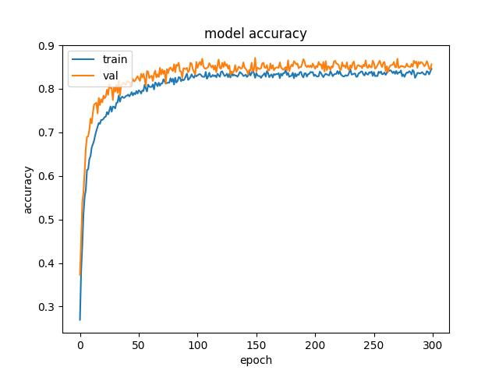
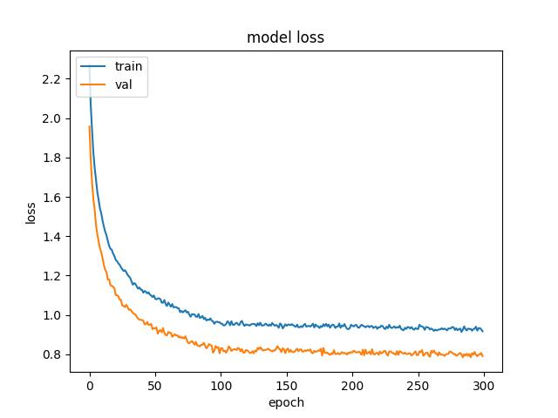
300 epochs , 0.2 dropout , 0.001 learning rate (reduced to 0.0001 after many epochs), 0.005 L2 regularisation, MAPGI disabled, Inceptionv3, 0 trainable layers

Slide 53
300 epochs , 0.2 dropout , 0.001 learning rate (reduced to 0.0001 after many epochs), 0.005 L2 regularisation, MAPGI disabled, Inceptionv3, 0 trainable layers
Class | cecum | esophagitis | polyps | pylorus | ulcerative-colitis | z-line
cecum | 188 | 0 | 10 | 1 | 3 | 0
esophagitis | 0 | 76 | 0 | 9 | 0 | 48
polyps | 2 | 0 | 200 | 3 | 1 | 0
pylorus | 0 | 2 | 1 | 193 | 2 | 2
ulcerative-colitis | 8 | 0 | 20 | 1 | 141 | 1
z-line | 0 | 35 | 1 | 30 | 0 | 121
Precision = 82.69 Accuracy = 94.54 Recall (Sensitivity) = 81.83 Specificity = 96.72 F1 score = 81.92

Slide 54
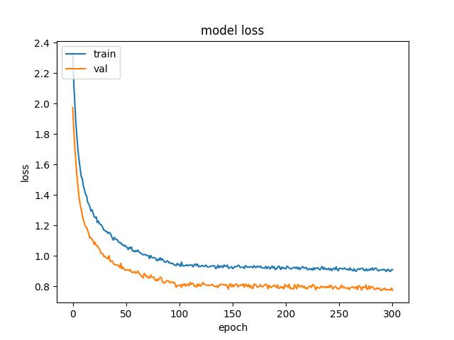
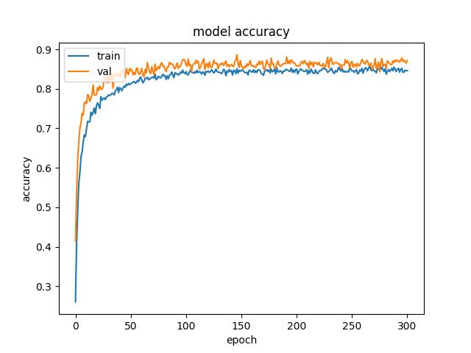
301 epochs , 0.2 dropout , 0.001 learning rate (reduced to 0.0001 after many epochs), 0.005 L2 regularisation, MAPGI enabled, Inceptionv3, 0 trainable layers

Slide 55
301 epochs , 0.2 dropout , 0.001 learning rate (reduced to 0.0001 after many epochs), 0.005 L2 regularisation, MAPGI enabled, Inceptionv3, 0 trainable layers
Class | cecum | esophagitis | polyps | pylorus | ulcerative-colitis | z-line
cecum | 194 | 0 | 5 | 0 | 3 | 0
esophagitis | 0 | 71 | 0 | 8 | 0 | 54
polyps | 2 | 0 | 192 | 5 | 7 | 0
pylorus | 0 | 4 | 2 | 187 | 0 | 7
ulcerative-colitis | 8 | 2 | 10 | 2 | 149 | 0
z-line | 0 | 16 | 0 | 8 | 0 | 163
Precision = 86.47 Accuracy = 95.66 Recall (Sensitivity) = 85.07 Specificity = 97.4 F1 score = 85.29

Slide 56
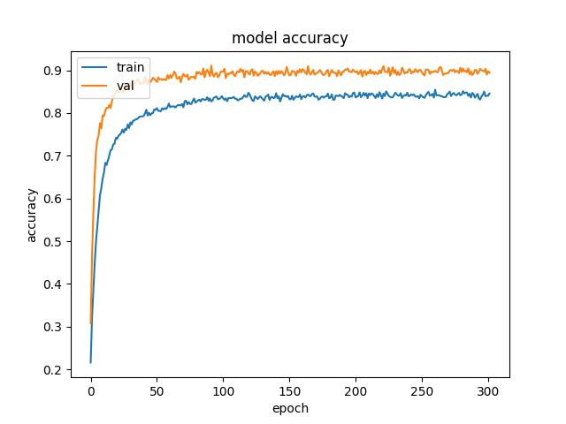
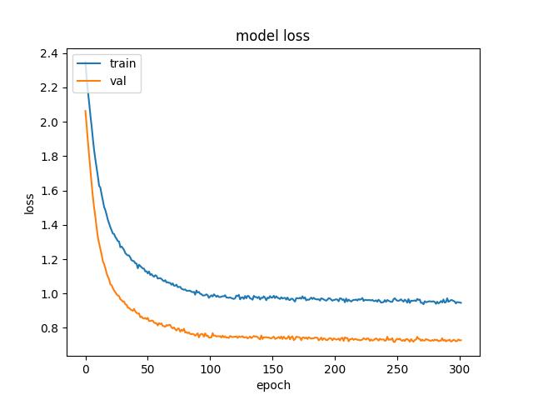
302 epochs , 0.2 dropout , 0.001 learning rate (reduced to 0.0001 after many epochs), 0.005 L2 regularisation, MAPGI disabled, EfficientNetB7, 0 trainable layers

Slide 57
302 epochs , 0.2 dropout , 0.001 learning rate (reduced to 0.0001 after many epochs), 0.005 L2 regularisation, MAPGI disabled, EfficientNetB7, 0 trainable layers
Class | cecum | esophagitis | polyps | pylorus | ulcerative-colitis | z-line
cecum | 196 | 0 | 3 | 1 | 2 | 0
esophagitis | 0 | 100 | 0 | 3 | 0 | 30
polyps | 3 | 1 | 193 | 4 | 5 | 0
pylorus | 0 | 5 | 1 | 190 | 0 | 4
ulcerative-colitis | 9 | 4 | 10 | 2 | 146 | 0
z-line | 0 | 35 | 0 | 5 | 0 | 147
Precision = 87.63 Accuracy = 96.15 Recall (Sensitivity) = 87.48 Specificity = 97.71 F1 score = 87.48

Slide 58
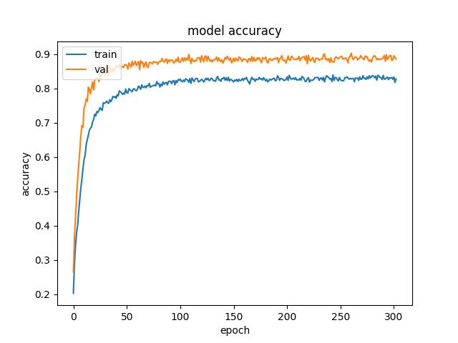
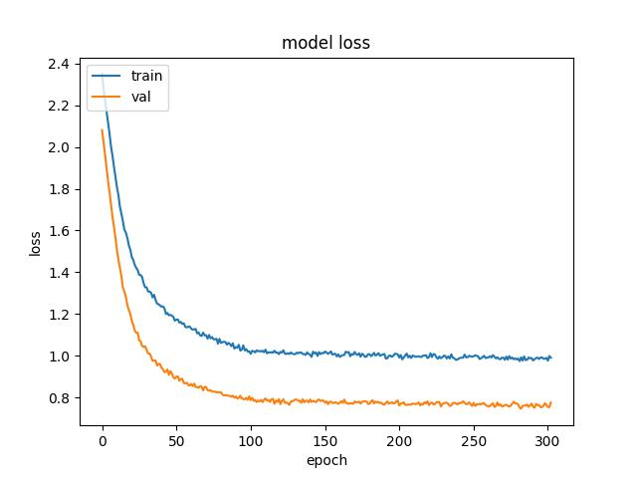
303 epochs , 0.2 dropout , 0.001 learning rate (reduced to 0.0001 after many epochs), 0.005 L2 regularisation, MAPGI enabled, EfficientNetB7, 0 trainable layers

Slide 59
303 epochs , 0.2 dropout , 0.001 learning rate (reduced to 0.0001 after many epochs), 0.005 L2 regularisation, MAPGI enabled, EfficientNetB7, 0 trainable layers
Class | cecum | esophagitis | polyps | pylorus | ulcerative-colitis | z-line
cecum | 199 | 0 | 2 | 1 | 0 | 0
esophagitis | 0 | 81 | 0 | 2 | 0 | 50
polyps | 8 | 0 | 188 | 5 | 5 | 0
pylorus | 1 | 2 | 0 | 193 | 0 | 4
ulcerative-colitis | 20 | 2 | 11 | 8 | 130 | 0
z-line | 0 | 11 | 0 | 3 | 0 | 173
Precision = 88.12 Accuracy = 95.91 Recall (Sensitivity) = 85.95 Specificity = 97.53 F1 score = 86.32

Slide 60
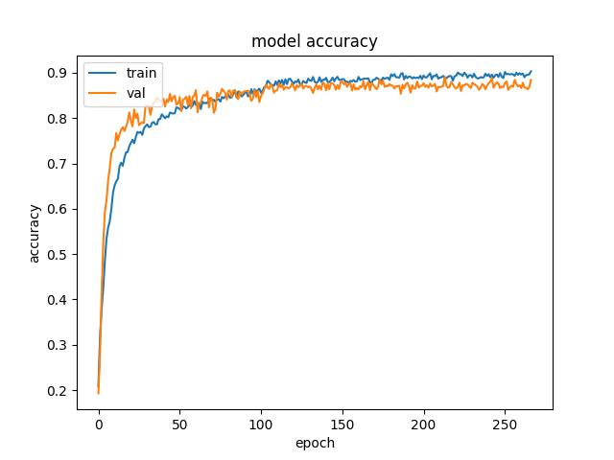

305 epochs , 0.2 dropout , 0.001 learning rate (reduced to 0.0001 after many epochs), 0.005 L2 regularisation, MAPGI disabled, Inceptionv4

Slide 61
305 epochs , 0.2 dropout , 0.001 learning rate (reduced to 0.0001 after many epochs), 0.005 L2 regularisation, MAPGI disabled, Inceptionv4
Class | cecum | esophagitis | polyps | pylorus | ulcerative-colitis | z-line
cecum | 191 | 0 | 2 | 0 | 9 | 0
esophagitis | 0 | 100 | 0 | 0 | 0 | 33
polyps | 1 | 0 | 191 | 2 | 12 | 0
pylorus | 0 | 0 | 2 | 195 | 2 | 1
ulcerative-colitis | 7 | 0 | 10 | 1 | 153 | 0
z-line | 0 | 53 | 0 | 2 | 1 | 131
Precision = 86.31 Accuracy = 95.81 Recall (Sensitivity) = 86.58 Specificity = 97.53 F1 score = 86.33

Slide 62


306 epochs , 0.2 dropout , 0.001 learning rate (reduced to 0.0001 after many epochs), 0.005 L2 regularisation, MAPGI enabled, Inceptionv4

Slide 63
306 epochs , 0.2 dropout , 0.001 learning rate (reduced to 0.0001 after many epochs), 0.005 L2 regularisation, MAPGI enabled, Inceptionv4
Class | cecum | esophagitis | polyps | pylorus | ulcerative-colitis | z-line
cecum | 189 | 0 | 0 | 0 | 13 | 0
esophagitis | 0 | 94 | 0 | 0 | 0 | 39
polyps | 1 | 0 | 183 | 1 | 21 | 0
pylorus | 0 | 2 | 4 | 187 | 2 | 5
ulcerative-colitis | 4 | 1 | 12 | 0 | 154 | 0
z-line | 0 | 29 | 0 | 3 | 0 | 155
Precision = 86.81 Accuracy = 95.84 Recall (Sensitivity) = 86.59 Specificity = 97.53 F1 score = 86.62

Slide 64


307 epochs , 0.2 dropout , 0.001 learning rate (reduced to 0.0001 after many epochs), 0.005 L2 regularisation, MAPGI disabled, NASNet, 0 trainable layers

Slide 65
307 epochs , 0.2 dropout , 0.001 learning rate (reduced to 0.0001 after many epochs), 0.005 L2 regularisation, MAPGI disabled, NASNet, 0 trainable layers
Class | cecum | esophagitis | polyps | pylorus | ulcerative-colitis | z-line
cecum | 190 | 0 | 4 | 0 | 8 | 0
esophagitis | 2 | 70 | 0 | 8 | 1 | 52
polyps | 3 | 0 | 198 | 1 | 4 | 0
pylorus | 6 | 5 | 4 | 174 | 1 | 10
ulcerative-colitis | 13 | 1 | 12 | 0 | 145 | 0
z-line | 0 | 26 | 0 | 10 | 0 | 151
Precision = 83.41 Accuracy = 94.81 Recall (Sensitivity) = 82.56 Specificity = 96.89 F1 score = 82.71

Slide 66


308 epochs , 0.2 dropout , 0.001 learning rate (reduced to 0.0001 after many epochs), 0.005 L2 regularisation, MAPGI enabled, NASNet, 0 trainable layers

Slide 67
308 epochs , 0.2 dropout , 0.001 learning rate (reduced to 0.0001 after many epochs), 0.005 L2 regularisation, MAPGI enabled, NASNet, 0 trainable layers
Class | cecum | esophagitis | polyps | pylorus | ulcerative-colitis | z-line
cecum | 193 | 0 | 3 | 0 | 6 | 0
esophagitis | 1 | 80 | 0 | 7 | 0 | 45
polyps | 2 | 0 | 190 | 2 | 11 | 1
pylorus | 2 | 2 | 2 | 182 | 3 | 9
ulcerative-colitis | 9 | 2 | 6 | 1 | 152 | 1
z-line | 0 | 22 | 0 | 9 | 0 | 156
Precision = 85.96 Accuracy = 95.57 Recall (Sensitivity) = 85.21 Specificity = 97.35 F1 score = 85.38

Slide 68
Comparison of metrics for 300-308 epochs cases
Network Used | MAPGI enabled? | Peak Validation Accuracy | Precision | Accuracy | Recall | Specificity | F1 score
Inceptionv3 | No | 86.8 | 82.69 | 94.54 | 81.83 | 96.72 | 81.92
Inceptionv3 | Yes | 87.8 | 86.47 | 95.66 | 85.07 | 97.4 | 85.29
EfficientNet | No | 90.8 | 87.63 | 96.15 | 87.48 | 97.71 | 87.48
EfficientNet | Yes | 89.8 | 88.12 | 95.91 | 85.95 | 97.53 | 86.32
Inceptionv4 | No | 88.4 | 86.31 | 95.81 | 86.58 | 97.53 | 86.33
Inceptionv4 | Yes | 87.4 | 86.81 | 95.84 | 86.59 | 97.53 | 86.62
NASNet | No | 87.3 | 83.41 | 94.81 | 82.56 | 96.89 | 82.71
NASNet | Yes | 88.0 | 85.96 | 95.57 | 85.21 | 97.35 | 85.38

Slide 69
From the analysis table in the previous slide, EfficientNetB7 is the best available network. We will use the same hyperparameters, but this time we will reduce the learning rate only when validation accuracy does not improve for 20 epochs.
We will also set the samplewise_std_normalization parameter in the ImageDataGenerator to False.

Slide 70


352 epochs , 0.2 dropout , 0.001 learning rate (reduced to 0.0001 after 20 epochs of no val_acc improvement), 0.005 L2 regularisation, MAPGI disabled, EfficientNetB7, 0 trainable layers, samplewise_std_normalization=False

Slide 71
352 epochs , 0.2 dropout , 0.001 learning rate (reduced to 0.0001 after 20 epochs of no val_acc improvement), 0.005 L2 regularisation, MAPGI disabled, EfficientNetB7, 0 trainable layers, samplewise_std_normalization=False
Class | cecum | esophagitis | polyps | pylorus | ulcerative-colitis | z-line
cecum | 199 | 0 | 1 | 0 | 2 | 0
esophagitis | 0 | 95 | 0 | 5 | 1 | 32
polyps | 16 | 0 | 177 | 3 | 10 | 0
pylorus | 0 | 3 | 0 | 195 | 0 | 2
ulcerative-colitis | 8 | 0 | 7 | 0 | 155 | 1
z-line | 0 | 24 | 0 | 9 | 0 | 154
Precision = 88.08 Accuracy = 96.24 Recall (Sensitivity) = 87.73 Specificity = 97.75 F1 score = 87.79

Slide 72


353 epochs , 0.2 dropout , 0.001 learning rate (reduced to 0.0001 after 20 epochs of no val_acc improvement), 0.005 L2 regularisation, MAPGI enabled, EfficientNetB7, 0 trainable layers, samplewise_std_normalization=False

Slide 73
353 epochs , 0.2 dropout , 0.001 learning rate (reduced to 0.0001 after 20 epochs of no val_acc improvement), 0.005 L2 regularisation, MAPGI enabled, EfficientNetB7, 0 trainable layers, samplewise_std_normalization=False
Class | cecum | esophagitis | polyps | pylorus | ulcerative-colitis | z-line
cecum | 197 | 0 | 3 | 0 | 2 | 0
esophagitis | 0 | 91 | 0 | 3 | 0 | 39
polyps | 12 | 0 | 179 | 4 | 11 | 0
pylorus | 1 | 3 | 1 | 192 | 0 | 3
ulcerative-colitis | 8 | 4 | 3 | 0 | 156 | 0
z-line | 0 | 27 | 0 | 2 | 0 | 158
Precision = 87.71 Accuracy = 96.18 Recall (Sensitivity) = 87.43 Specificity = 97.72 F1 score = 87.48

Slide 74
Comparison of metrics for old and new EfficientNet models
Test Case | MAPGI enabled? | Peak Validation Accuracy | Precision | Accuracy | Recall | Specificity | F1 score
Old EfficientNet | No | 90.8 | 87.63 | 96.15 | 87.48 | 97.71 | 87.48
Old EfficientNet | Yes | 89.8 | 88.12 | 95.91 | 85.95 | 97.53 | 86.32
New EfficientNet | No | 88.7 | 88.08 | 96.24 | 87.73 | 97.75 | 87.79
New EfficientNet | Yes | 88.4 | 87.71 | 96.18 | 87.43 | 97.72 | 87.48

Slide 75
Conclusion
Highlighted 352 epochs case is the best case in our entire project. There is a slight improvement from the original case of EfficientNet. Thus, lr scheduling and disabling sample-wise normalization can have a positive impact on performance (at the expense of validation accuracy).
The only thing we haven't tried yet is dynamic variation of number of active training layers (by mid-training freezing), analogous to lr scheduling. But, we presume that this would have a negligible impact on our model.

